Slide 1


PROGRAM RECOMMENDATION
PROCESS

Slide 2

Introduction to Program Recommendation
Overview of the CVML Program Recommendation Process
Requesting & Utilizing a Labor Market Information (LMI) Report from CVML COE
Submitting a Program for Recommendation

Slide 3

Introduction to the Program Recommendation Process
Guiding Legislation
Guiding Legislation: California Ed Code and the California Code of Regulations (CCR), Title 5
Requirement: Career technical education programs submitted for chaptering to the California Community Colleges Chancellor’s Office (CCCCO) must include in the application the recommendations of the career technical education regional consortium (CVML for the Central Valley Mother Lode Region).
CVML Recommending Body: The CVML Steering Committee is made up of a voting and alternate voting member from each of the 15 community colleges, is responsible for recommending programs.
PCAH
Submitted programs must align with the current iteration of the Program and Course Approval Handbook (PCAH) issued by the Chancellor’s Office (available on the CVML Website)
All submitted programs MUST align with requirements identified in the PCAH and the approved LARC program recommendation processes.

Slide 4

CVML’s Role in Program Recommendation
What is CVML’s role in program approval?
  The CVML Steering Committee reviews and recommends programs at their monthly business meeting to the Chancellor’s Office for approval.
What is NOT CVML’s role in program approval?
  The CVML Steering Committee does not approve programs, but recommends them. The Chancellor’s Office is the sole approver of programs.
  Curriculum development and approval is a local process.

Slide 5
WHEN IS PROGRAM RECOMMENDATION APPLICABLE PER THE PCAH?
Programs Subject to This Process:
  New, credit CTE programs
  Existing low-unit, local certificates for state chaptering
  Modified programs requiring a new control number in COCI
Programs NOT Subject to This Process:
  Modified programs that do not require a new control number in COCI (may still submit if preferred by college)
  Noncredit programs
  Associate Degrees for Transfer

Slide 6

Existing Low-Unit, Local Certificates for State Chaptering
Potential Existing Low-Unit, Local Certificates for State Chaptering
  Set/sequence of certificates that meet the following criteria:
    Single 4-digit TOP Code
    Lower-level certificate(s) required for higher level certificate(s)
    Set or sequence combined that meets 16+ semester units (or 24+ quarter units)
  Existing certificate that is being increased to 16+ semester units (or 24+ quarter units)
PCAH Example
The Program and Course Approval Handbook (PCAH) provides an example of low-unit, local certificates for state chaptering that are subject to the program recommendation process (see PCAH, page 95).

Slide 7
When is a new control number required in COCI?
  Please contact your campus curriculum specialist with any questions regarding whether a change requires a new control number in COCI. The college must determine if a new control number is required.
  Additional information regarding what changes may require a new control number in COCI may be found in the California Community Colleges Curriculum Submission & Approval Technical Manual.
  An instructional with information from the manual is available on the CVML Program Recommendation page
SUBSTANTIAL CHANGES REQUIRE a New Control Number | NON-SUBSTANTIAL CHANGES Do NOT Require New Control Number
Substantial change to qualitative content of a course (at the discretion of the college faculty in accordance with California Code of Regulations, title 5, section 55002 [Standards and Criteria for Courses]) Course TOP Code Course Credit Status Units of Credit - Maximum Units of Credit - Minimum Course Basic Skills Status Course SAM Priority Code Course Prior to Transfer Level Course-Program Applicable Code | Course Department and Number Course Title Course Transfer Status Course Cooperative Work Experience Education Status Course Classification Status Educational Assistance Class Instruction (Approved Special Class) Course Classification Status Funding Agency Category Course Program Status Course Upper Division Status

Slide 8
Program Recommendation Process Overview
CVML Recommendation
Checklist
  An LMI report is requested from CVML COE
  via their form.
  College submits an application to the
  Regional CTE website.
  Application is reviewed for requirements.
  Applications are sent out to committee members to review or returned to submitter for required information to resubmit for review.
  Program Recommendation Minutes are created, reviewed, and approved.
  Official meeting minutes are sent to the program submitter via email. The approved minutes are also uploaded to the CVML website
  Checklist
  College ensures the following are complete/available:
    COE LMI Report (dated within 1 year, for the program)
    Advisory Minutes (dated within 2 calendar years, reference program)
  CVML Steering Committee voting members will review, discuss and recommend or not recommend all submitted program applications
LMI Request
Regional CTE Application
Recommendation Documentation

Slide 9
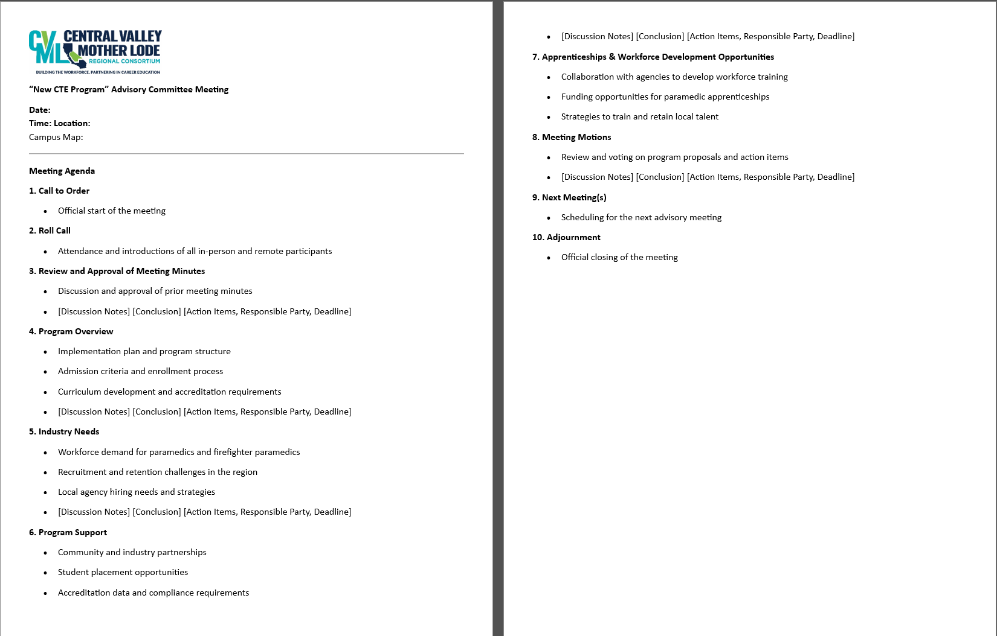
Sample Advisory Agenda:
Advisory must “recommend”, “approve” or “vote” for program
Sample Advisory Minutes

Slide 10

Registering for Regional CTE
Must have an account and be logged in to submit an application
Select the “Register” link to create an account
Must utilize college email when registering
Multiple Colleges
  If you submit programs for multiple colleges, you should select the college you work with most when registering.
  The college will need to be updated during the application process whenever submitting a program for a different college.

Slide 11
Helpful Program Submission Tips

Slide 12


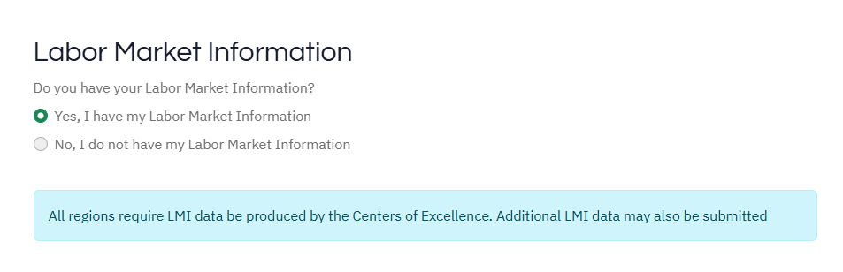
Submitting an Application:
Labor Market Information
A valid LMI report issued by the CVML Center of Excellence is required for any application submitted in Regional CTE.
Please do not proceed unless you have an LMI report issued by COE that is…
For the respective program/TOP Code, Issued for the CVML Region college, and dated within one (1) calendar year of submission.

Slide 13
Submitting an Application: Program Details
Program Title
The program title must match exactly what is going to be submitted to COCI.
Submission Type
New Program:
New, credit CTE programs
Existing low-unit, local certificates for state chaptering
Program Modifications (formerly substantial changes):
Modified programs requiring a new control number in COCI

Slide 14
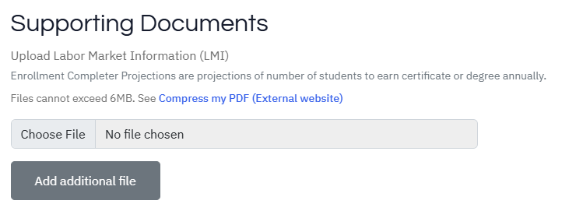
Submitting an Application: Supporting Documents
Upload Labor Market Information (LMI)
The respective LMI report must be uploaded in the Supporting Documents section. The LMI report must be:
Issued by CVML COE,
For the respective program/TOP Code,
For the respective submitting college, and
Issued within one (1) calendar year of the application’s submission.
The application will not be accepted if the LMI report is not included.

Slide 15
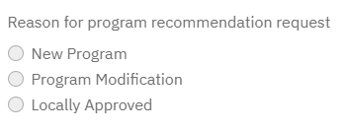
Submitting an Application: CVML Regional Questions
District & College
Must be the district and college requesting recommendation of the program.
Reason for Program Recommendation Request
New Program: New credit CTE programs
Program Modification: Modified programs requiring a new control number in COCI
Locally Approved: Existing low-unit, local certificates for state chaptering
If the application is for a program modification, a description of changes to the program must be included. A bulleted list of key changes is acceptable.
If the application is not for a program modification, “Not applicable” may be included in the space provided

Slide 16
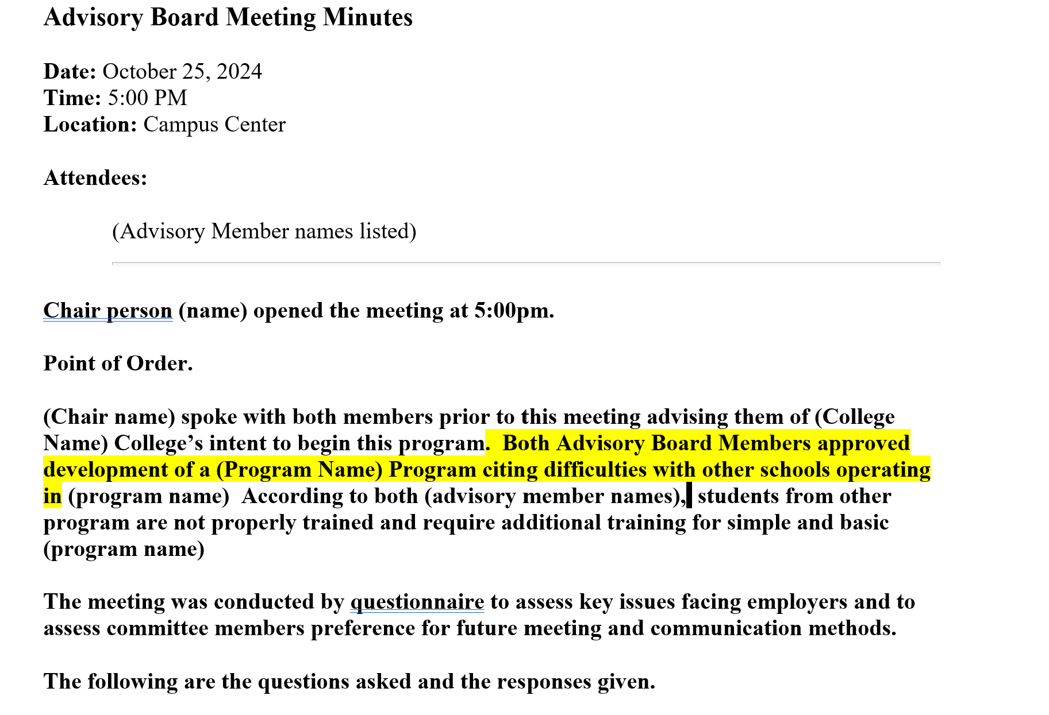
Submitting an Application:
Example of highlighted recommendation on advisory minutes
Advisory Minutes
Reference the Respective Program
Dated Within Two (2) Calendar Years
Preferred: Highlight the relevant sections of the minutes that note the discussion and approval of the respective program

Slide 17
Regional CTE Website
Technical Issues
If you have any technical issues with submitting your application, please reach out to the Regional CTE web support team via the following email: support@regionalcte.org.
Please allow adequate time for troubleshooting.
Website Training
The previously provided website training provided by the Regional CTE web support team may be accessed via the Regional CTE website: https://regionalcte.org/dashboard/training. (Only those logged into Regional CTE will have access to the resource.)

Slide 18
APPLICATION REVIEW

Slide 19
CVML Program Recommendation Minutes
Once the final recommendations have been determined during the respective steering committee meeting, the CVML Meeting Minutes are created, reviewed, and approved minutes are emailed to the program submitter within 1-2 weeks after the meeting.
The approved SC minutes are also uploaded to the CVML website The minutes may be accessed through the Meeting Archives or
The CVML Program Recommendation Minutes serve as the documentation of the career technical education regional consortium recommendation of the program, which is a required attachment with the application submitted to the Chancellor’s Office.

Slide 20

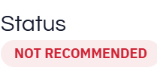
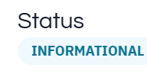
CVML Program Recommendation: Final Steps
Regional CTE
The status of the Regional CTE application is updated according to the final LAWC recommendation:
Recommended: New program application has been recommended
Informational: Modified program has been recommended
Not Recommended: Program has not been recommended

Slide 21
Contact Information
CVML Program Recommendation Contact
Program Director, SWP Rebecca Murillo, Rebecca.Murillo@kccd.edu
Center of Excellence (LMI Reports/Data)
Request LMI: LMI request link
Interim Director,Patricia Salinas, patricia.salinas@scccd.edu
Regional CTE Website Technical Support
Contact: support@regionalcte.org

