Slide 1
Chancellor’s Office Updates for Regional Consortium - CCCAOE
October 23, 2024

Slide 2
Vision 2030 Goals: Equitable Workforce and Economic Development
Vision 2030 furthers the sector approach to workforce development through more partnerships between community colleges and industry to invest in hands-on training for career readiness.
The priority sectors are health care, climate, STEM and technology, education and early education.
Health care: Expand access to health care pathway programs with particular attention to nursing, mental and behavioral health.
Climate action: Advance community college engagement with the four fields of climate practice — facilities, workforce and curriculum, community engagements and benefits, and resource development.
STEM: Expand success, access and support in science, technology, engineering and math disciplines for historically underrepresented students.
Education: Increase system capacity to decrease faculty shortages in key sectors including nursing, early childhood pathways and education.
Resource: Vision 2030 website

Slide 3
Strong Workforce Program Updates
SWP Expenditure Timeframes
The 2024-2025 allocation has a 24-month expenditure timeframe.
Plans are due October 31, 2024
Local SWP Staff Changes
If a college or district experiences SWP staffing changes, be sure to inform the Chancellor’s Office Regional Monitor. The Regional Monitor can assist in making the SWP responsible person updates in NOVA.

Slide 4
Strong Workforce Program Updates
SWP Fiscal Reporting Reminders
FY 2022-23 (R7): Q4/Final Report due November 15, 2024
Same due dates for Local and Regional Plans
All SWP reporting deadlines can be found on the program’s webpage under the ‘Planning and Reporting Dates’ section: https://www.cccco.edu/About-Us/Chancellors-Office/Divisions/Workforce-and-Economic-Development/Strong-Workforce-Program.

Slide 5
Perkins Program Updates
Perkins Fiscal Reporting Reminders
FY 2024-25 Allocation
Q1 report due 10/31
New questions for this fiscal year; Additional CLNA-related questions, per WEDD Memo
Upcoming Events
Perkins Professional Development Series:
Part 1, November 7, 2024 - 9:30 to 11:30 a.m.
Part 2, November 13, 2024 - 12:00 to 1:30 p.m.

Slide 6
Adult Education Program
CAEP
Year 1 (FY 23-24) of AB 1491 carryover compliance tracking has completed
33 consortia have been flagged with exceeding the 20% carryover threshold.
Written Expenditure Plan flagged in NOVA for consortia to complete.
Due November 14th and extensions are available.
Year 2 Member level carryover tracking has begun with FY 24-25. Members should be reviewing and addressing excess carryover. Refer to Policy Guidance to review AB1491 member impact.
ELL Healthcare Pathways
Round 2 Intent to Award Memo has been released. Memo is available on the Chancellor’s Office website.
Staff will begin processing grant agreements in the coming weeks and will be reaching out to the designated fiscal agent.

Slide 7
Apprenticeship
CAI grants:
FY 2023-24: 79 New CAI Allocations were funded with $37 Million.
FY 2024-25: 37 New CAI Allocations were funded with $19 Million.
RSI – FY 2024-25 Allocation
Total Allocation: $94,407,000
CCD Allocation: $34,690,000
LEA Allocation: $59,717,000
Upcoming Due Date:
ReCal for FY23-24 is due on 1st November 2024.

Slide 8
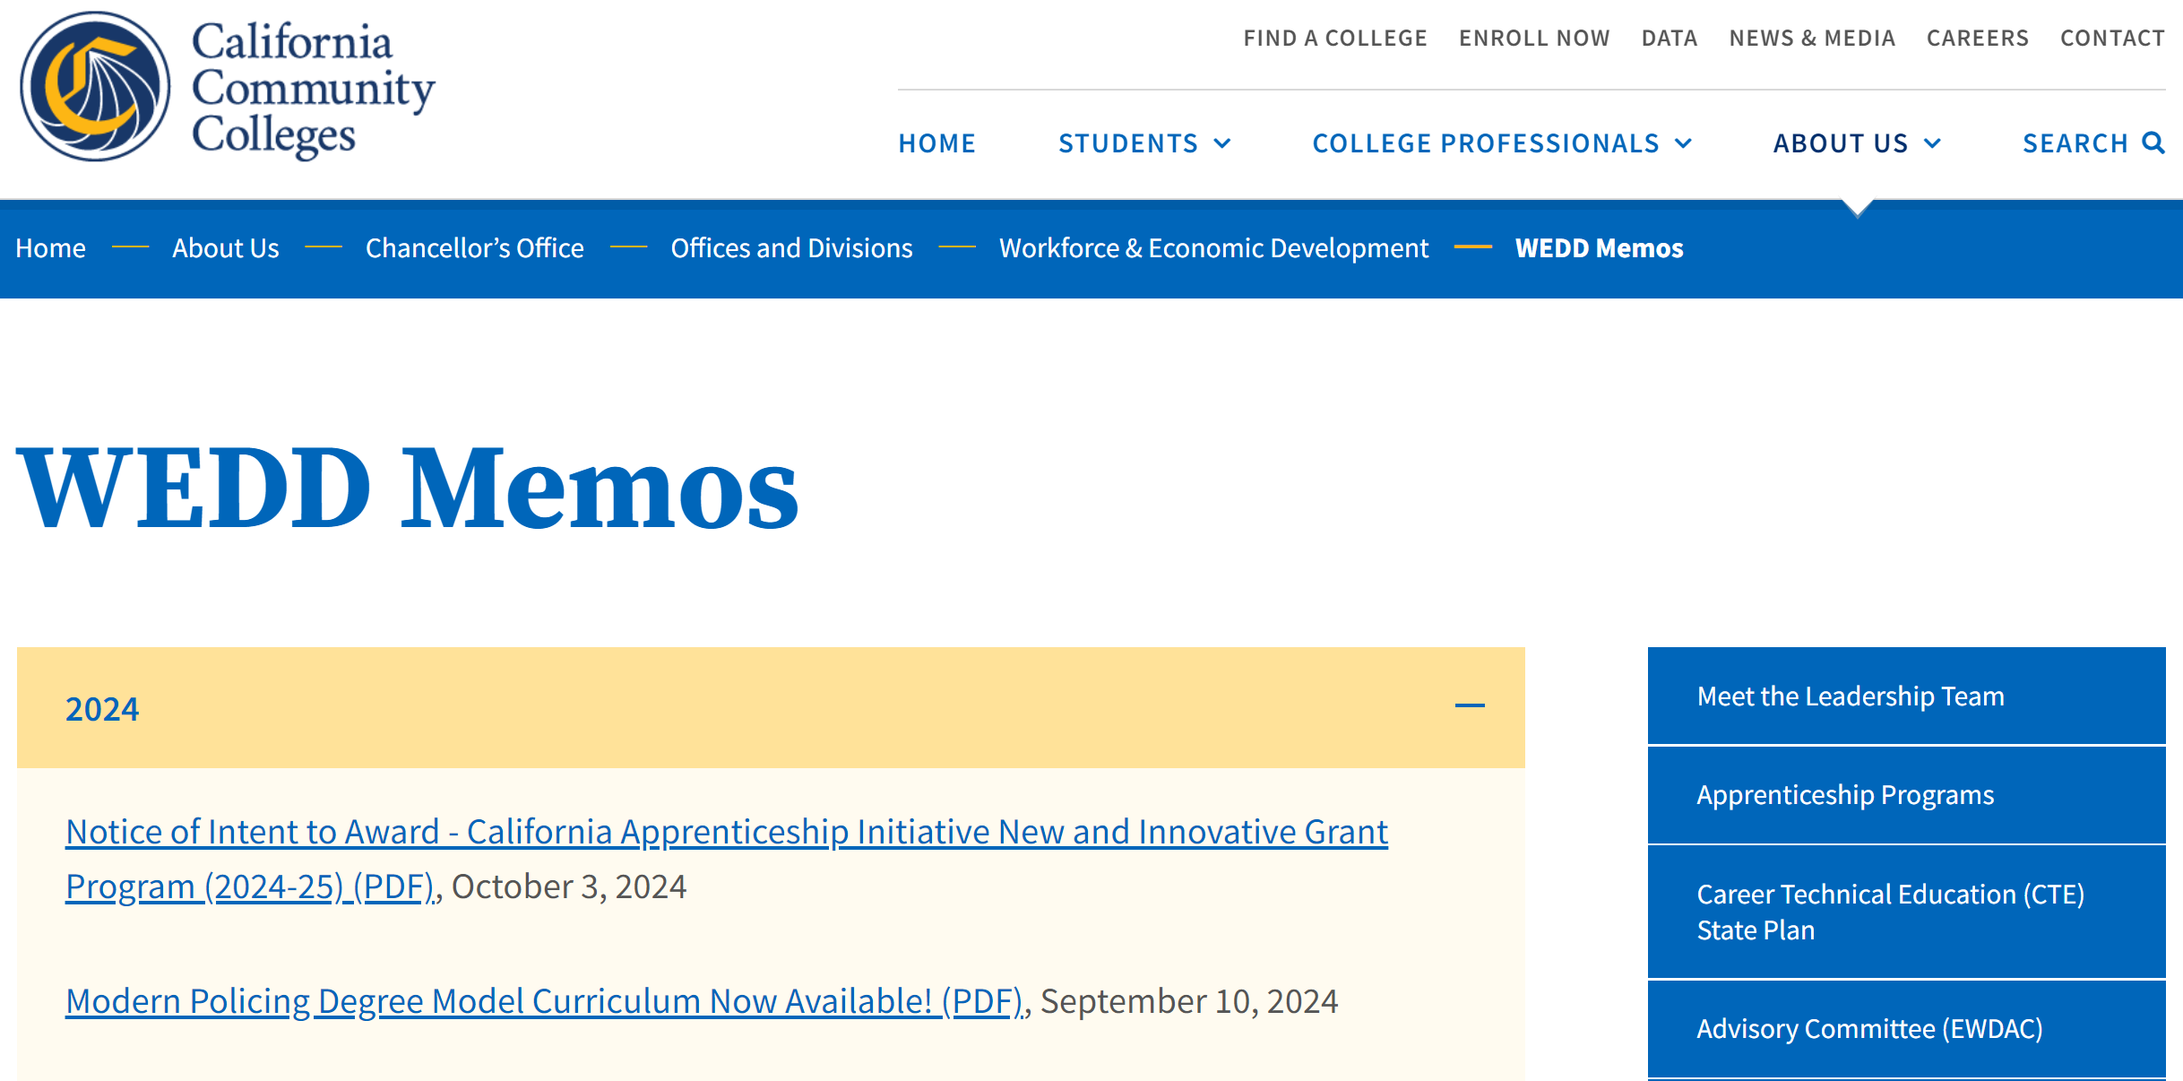
Policy Updates and Announcements
https://www.cccco.edu/About-Us/Chancellors-Office/Divisions/Workforce-and-Economic-Development/WEDD-Memos
Notes:
Talking Points:
Check the Chancellor's Office Website for the latest memos and announcements.

Slide 9
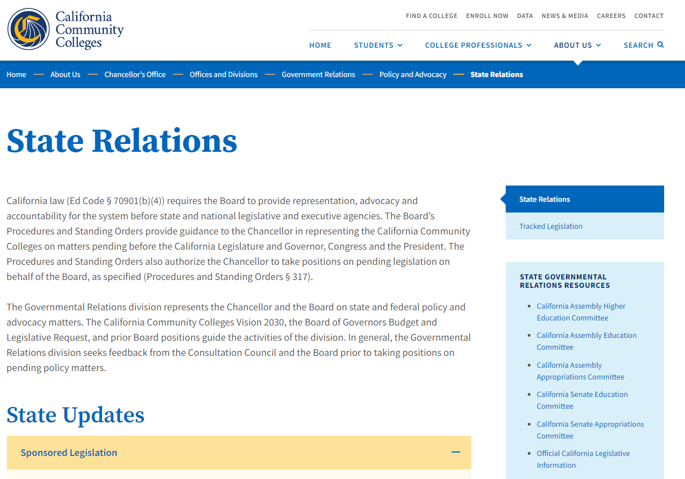
State Relations and Legislative Updates
https://www.cccco.edu/About-Us/Chancellors-Office/Divisions/Governmental-Relations/policy-and-advocacy/State-Relations
Notes:
Talking Points:
Check the state relations page on the CO website for legislative updates and advocacy activities.

Slide 10
Contacts & Resources
Regional Monitor: Dalbir Singh Dsingh@cccco.edu
MIS Team: cccmisedit@cccco.edu
WEDD Website
2024-25 California Community Colleges Compendium of Allocations and Resources (October version)

