Slide 1
CVML New Dean Retreat June 10, 2024

Slide 2
Agenda
Part 1 – Congratulations, you are a Dean!
The System
The Rules
The Dean
The Work
Part 2 – Oh wait, you’re a CTE Dean…
What is CTE?
CTE Programs and Funding Sources
Part 3- Budgeting
Part 4 - NOVA

Slide 3
Part 1: Congratulations – you are a Dean!!!
`

Slide 4
Where have I landed???

Slide 5
The System
California Community Colleges (CCC)
Structure
History
CCC Governance
Board of Governors
Chancellor’s Office
Accreditation

Slide 6
California Community Colleges
California Community College System
Postsecondary Education System
72 Community College Districts governed by locally elected trustees
116 Community Colleges – 117th is Calbright (online)
Part of California’s 3 tier public higher education system
UC, CSU, CCCS
History
Fresno City College – 1910
Junior Colleges Act 1917
1960 Master Plan for Higher Education
Donahoe Act: UC and CSU limit enrollments
Free tuition to all California Residents – (1978 per-unit enrollment fees)
California State Legislature created the Board of Governors for the Community Colleges, formally establishing the CCCS - 1967
BOG oversees CCCS
Required all areas of the state to be included within a Community College District

Slide 7
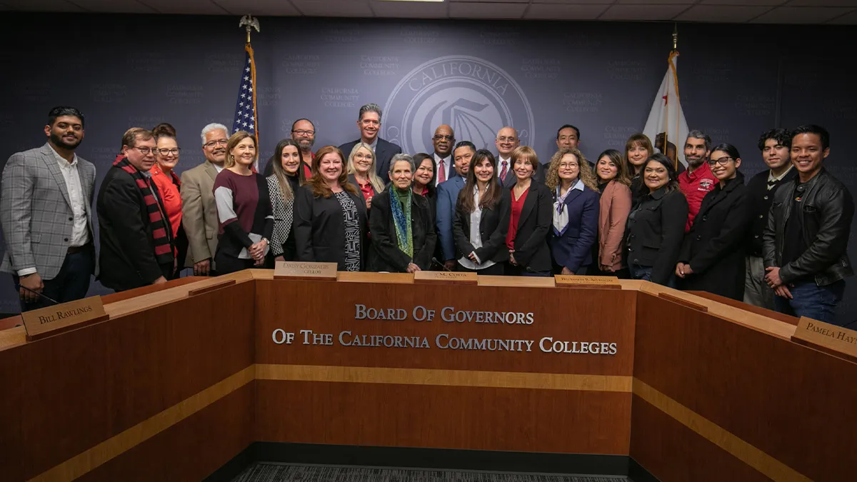
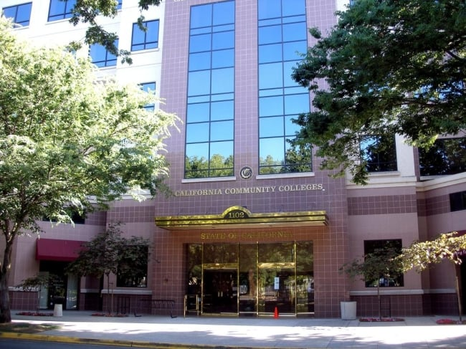
California Community Colleges Governance
CCCCO is governed by the Board of Governors
17 Members
Appointed by the Governor of CA as per Section 71000 of California Education Code
BOG sets system-wide policy
Ed Code also directs BOG to allow local authority to “maximum degree permissible”
California Community College Chancellor’s Office
Provides leadership and technical assistance to Community Colleges
Implements BOG policies
Brings recommendations to BOG

Slide 8
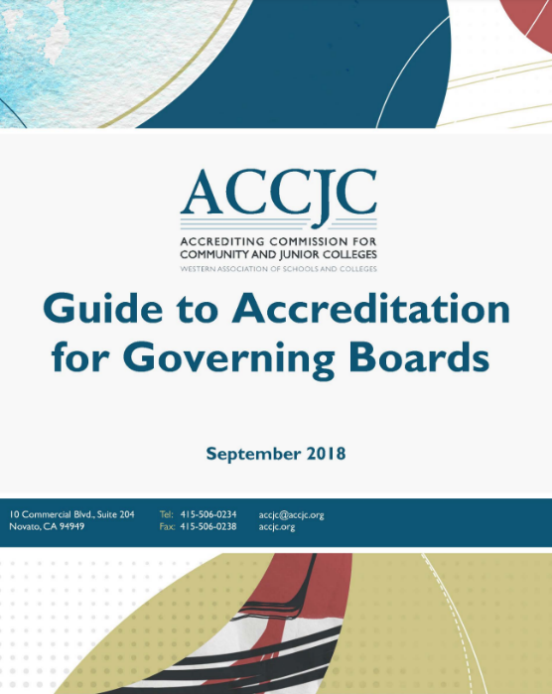
Accreditation
Accrediting Commission for Community and Junior Colleges (ACCJC)
Part of the Western Association of Schools (WASC)

Slide 9
The Rules
State law and regulations
California Education Code
California Code of Regulations (CCR)
CCR – Title 5
Participatory Governance
10+1
Local CCD Board Policies and Administrative Procedures
FERPA

Slide 10
Who is Ed Code?

Slide 11
CA Ed Code and CCRs
California Education Code
A collection of all laws directly related to California K-12 public schools
Resulting from legislation
May also be changed by budget action
California Code of Regulations
An official compilation of regulations adopted, amended or repealed by state agencies – the CCCCO is a state agency
Regulations are filed with the Secretary of State and have the force of law
CCR is organized in “Titles”
Title 5 - Education
Title 5, Division 6 – CCC is derived and approved by the Board of Governors
https://casetext.com/regulation/california-code-of-regulations/title-5-education

Slide 12
Key Sections of Title 5
Section 53200 (b)
Defines Academic Senates
Section 53200 (c)
Lists 10 + 1
Section 53200 (d)
Defines “consult collegially”
Section 55002
Defines Curriculum Committee: how formed, role
Standards for Credit/Noncredit/ Community Ed
Section 53203
Defines Academic Senate Powers
Section 53021
Requirements for recruitment for all positions

Slide 13
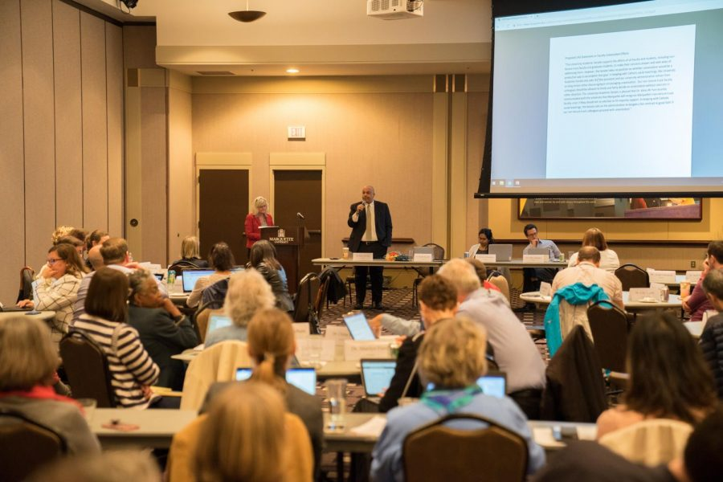
Participatory Governance
California AB 1725 - 1988
Collegial model of governance where faculty is involved in decision-making in faculty-related areas (10+1)
Philosophical separation from K-12
Encourages inclusion of diverse viewpoints
Promotes trust and cooperation
Academic Senate
Curriculum Committee

Slide 14
Section 53200 (c) 10 + 1
curriculum, including establishing prerequisites and placing courses within disciplines;
degree and certificate requirements;
grading policies;
educational program development;
standards or policies regarding student preparation and success;
district and college governance structures, as related to faculty roles;
faculty roles and involvement in accreditation processes, including self-study and annual reports;
policies for faculty professional development activities;
processes for program review;
processes for institutional planning and budget development; and
other academic and professional matters as are mutually agreed upon between the governing board and the academic senate.

Slide 15
Board Policies & Administrative Procedures
The Board of Trustees adopt policies which serve as the voice of the Board
The Board delegates authority to the Superintendent/President through policy
Board Policies
Implement and interpret federal and state statutes and regulations.
Do not cover all laws and requirements that apply to the District
Not intended to and cannot conflict with or override the law
Approved by Board of Trustees
Administrative Procedures
Developed to provide for implementation of the policies adopted by the Board of Trustees
Specific and include details of policy implementation, responsibility, accountability and standards of practice
Reviewed by Board of Trustees
Not all Board Policies have a corresponding Administrative Procedure, and not all Administrative Procedures have an associated Board Policy
Example:
Kern CCD Board Policies & Procedures: https://www.kccd.edu/board-trustees/board-policy.html

Slide 16
Family Educational Rights and Privacy Act (FERPA)
FERPA statute is found at 20 U.S.C. § 1232g and the FERPA regulations are found at 34 CFR Part 99
Federal law that affords parents the right to have access to their children's education records, the right to seek to have the records amended, and the right to have some control over the disclosure of personally identifiable information from the education records
When a student turns 18 years old, or enters a postsecondary institution at any age, the rights under FERPA transfer from the parents to the student ("eligible student")

Slide 17
The Dean
Roles and Responsibilities
Management Rights and Duties
Curriculum & Program Reviews

Slide 18
Dean…..the Manager, the Myth, the Legend…..
The Joy of Middle Management
You are NOT alone….
Remember it is a Marathon not a Sprint

Slide 19
Roles and Responsibilities
Primary Duties:
Leads and directs the operations of the College
Hiring/Staffing/Scheduling
Evaluations
Budget
Additional Duties:
Leads the development of new programs and curriculum in response to evolving industry needs
Engages faculty in formulating best pedagogical practices that promote the principles of DEIA in support of student learning
Emphasizes student success and facilitates continuous improvement of programs
Ensures compliance with local, state, and federal laws and regulations
Participatory Governance
Participates on a variety of campus-wide projects and committees
Conducts regular meetings with faculty

Slide 20
Management Rights and Duties
Know your Collective Bargaining Agreement (CBA)
Ensure implementation and protection of management rights
Failure to exercise the rights of management may establish a past practice
Areas not subject to negotiation
Set standards and level of service
Determine means and methods of operations
Hire, promote, transfer, and assign employees
Direct and manage the work of employees
Evaluate performance of employees
Determine hours of operations
Establish standards of productivity (BUT negotiate the effects of the decision)
Grievances
Definition of a grievance: violation of a clause of the CBA. (If the subject is not covered in the CBA, it is not grievable by the union)
Pay special attention to timelines for response/resolution – BP/AP
Practical advice:
Prepare for the meeting
Listen carefully at the meeting
Get the facts/investigate
Issue a written response after the meeting
Follow up
DO NOT SETTLE A GRIEVANCE WITHOUT FIRST NOTIFYING HR.

Slide 21
Curriculum & Program Reviews
Faculty are responsible for Curriculum and Program Reviews (10+1)
Pursuant to California Administrative Code of Regulations -Title 5, Section 53200, the Academic Senate is a faculty organization whose primary function is to make recommendations to the Board of Trustees on 10+1 academic and professional matters.
Board of Trustees
Approves all new courses and programs
Approves all substantive changes to courses and programs
Relies on Academic Senate
Dean functions
Advise on any new programs or curriculum and attempt to guide conversation
Provide formal feedback in software (eg CurricUNET)
Ensures all reviews take place in a timely manner
Attend your College’s Curriculum Committee

Slide 22
The Work
Programs
Hiring
Hiring Process
Mentoring
Evaluations
Scheduling
Section Development & Section Management
Contact hours and FTES calculation
FTE calculation
Flex days

Slide 23
Know your Programs
Courses
Units
Certificates, Degrees, Transferability
Articulation/Dual Enrollment
Pre-Apprenticeship/Apprenticeship
Accreditation Bodies (e.g., BRN, CDPH, PVNPT,CODA)
Catalogue, Website, Faculty Chairs/Coordinators
You are the ambassador for your Division

Slide 24
Know your Programs
Is there a complete program description?
Program SLOs & Assessment
Are SLOs focused on student learning?
Is there an assessment plan/activity?
Student Achievement and Analysis
Has achievement data been cited and analyzed?
Program Improvement Objectives
Program Review
Every 3 years
CTE – every 2 years, requires advisory committees, LMI data

Slide 25
Hiring
One of a Dean’s key tasks
50% Law
California Education Code Section (EC) 84362 (also known as the Fifty Percent Law) requires all community college districts to spend at least half of their “current expense of education” for “salaries of classroom instructors.”
Review the CBA
Reach out to HR regarding the Hiring Manual
Review AP 7120/BP 7120
Example: KCCD AP 7120/ BP 7120
References: Education Code Sections 87100 et seq., 87400, and 88003; ACCJC Accreditation Standard III.A.1
https://www.kccd.edu/board-trustees/_documents/board-policy/chapter-7/AP_7120.pdf

Slide 26
Hiring Process
Faculty Hiring
Position Identification/Approval – President & Academic Senate
Contract – College President & District Chancellor
Position Announcement
Department/Division Chair & Faculty in consultation with Administrator shall develop Announcement
All positions shall meet Minimum Qualifications
Search Procedure
Prepared by College Personnel Officer
Reviewed by College President, EEO, Assistant Chancellor of Personnel or designee
Length of advertising to ensure good pool

Slide 27
Hiring Process Screening Procedures – HR & CBA
Faculty (Full Time):
Selection of Screening Committee
Faculty members appointed by Academic Senate
Administrator appointed by the College President
Equal Employment Opportunity Compliance Monitor appointed by HR (faculty if possible)
Convene initial meeting
HR receives application & screens for minimum qualifications
Screening Committee conduct interviews
Chair leads discussion Strength/Weaknesses
Recommends 2 or more Finalists
Selection of Final Candidate
President reviews recommendations ( in consultation with the Chair)
Sends recommendation to Chancellor and BOT
Notification of candidates – formal offer prepared and issued by HR

Slide 28
Hiring Process
Faculty (Part Time):
Search Procedures
Position Announcement – District HR will publish list of potential open part time faculty positions
Qualified Applicant Pools – HR will maintain
Screening Committee
Faculty Chair and Educational Administrator or designee and additional discipline faculty

Slide 29
Mentoring
New Faculty
Mentors should be excellent campus citizens with a positive attitude
Mentors receive Flex Credit or Stipend

Slide 30
Evaluations
One of the MOST important tasks
Ongoing process
Ensures all reviews take place regularly in a timely manner (Ed Code 87663)
Frequency (follows timelines outline in BP/AP and CBA)
Probationary faculty – at least once per academic year
Tenured faculty – at least once every 3 years
Temporary (adjunct) faculty – at least once every 3 semester
Methodology
Establish the criteria for the evaluation (as per CBA)
Gather and document observations
Conduct face to face meeting
Make your comments factual and clear
Note accomplishments as well as negative performance issues
Performance Improvement Plans and Discipline

Slide 31
Scheduling
Focus on the needs of the Student
Establish time blocks for efficiency
Use Chancellor’s Office approved time blocks
Schedule according to Master Plan
Many colleges use 2-year cycle
Look at Fill Rate
If Cap is 45 and have 35 = 77% Fill rate (want approximately 80%)
If Fill Rate above 90% or large wait list, then may need additional section
Think Pyramids
Beginning, Intermediate, Advanced
Follow the Transfer Patterns of your College
Know your CBA and AP/BP
Part-time faculty can only teach 67% of a full-time faculty load – District Limit
Exception is nursing – can only exceed two semesters every 3 consecutive years
Community Education is exempt

Slide 32
Section Development & Section Management
Guided Pathways
Modalities to support student need
Full-time
Part-time
Evening & Weekend
Dual Enrollment
Noncredit
CTE
ESL

Slide 33
Contact Hours and FTES calculation
Weekly Census – holidays NOT taken into account
Example: 3 unit lecture (54 hours) that meet twice a week
54 hours/17.0 Term Length Multiplier/number of times the class meets per week (in this example 2) = 1.588 contact hours or 1.6 CH = 1:20
Daily Census – holidays are taken into account
Example: 3 unit lecture (54 hours) offered during Summer Session (8 weeks) twice a week with no holiday
54 hours/16 days = 3.375 contact hours or 3.3 CH = 3:05
Example: 3 unit lecture (54 hours) offered during Summer Session (8 weeks) twice a week with 1 holiday
54 hours/15 days = 3.6 contact hours = 3:20

Slide 34
FTE Calculation
WSCH – Weekly Student Contact Hours
Represents Enrollment
Total WSCH = (# weekly contact hours) X (Standard Term Length Multiplier) X (# Students)
FTES – Full Time Equivalent Student
FTES generated by the course = (Total WSCH) / 525 (WSCH that equal 1 annual FTES or 30 units)
FTEF – Full Time Equivalent Faculty
Represents Cost
CBA for Teaching load calculation
Higher enrollment results in higher WSCH to FTEF ratio (smaller class sizes smaller ratio)

Slide 35
Flex Days
A flexible calendar program initiated in 1976 by 6 California Community Colleges in 1976 as a pilot program.
Six colleges: El Camino, Grossmont, Consumnes River, Saddleback, San Jose City, and Evergreen Valley
Authorized by Assembly Bill 2232 (1975)
Reduced number of required instructional days from 175 to a minimum of 160
Replace up to fifteen days of regular instruction with alternative activities:
Course and program development and revision
Development of new instructional materials
Staff development activities

Slide 36
Students
Prerequisite/Corequisite
BP/AP
Based on scheduling
Degree Completion
Late Registration Requests
Pull rosters every day – some students think enrolled but haven’t
Student should attend by Census
Student success – every week, student falls further behind
Overlapping Course Petitions
Title 5 Section 55007 (also in BP/AP 4226)
Subject to state audit
Valid reasons: Degree completion
Hours missed must be made up – Faculty provides documentation at end of semester

Slide 37
Students
Grade Disputes/Appeals
Follow Title 5 Section 55758 (also BP/AP)
"In any course of instruction in a community college district for which grades are awarded, the instructor of the course shall determine the grade to be awarded each student in accordance with section 55758* of this chapter. The determination of the student's grade by the instructor shall be final in the absence of mistake, fraud, bad faith, or incompetency."
Follow steps of policy
Grade Petition Form
Resources for Students
Tutoring & Learning Center
Health & Wellness
Transfer and Career Services
Veterans Services
Don’t forget FERPA…

Slide 38
Start Here…
Success Requires Relationships
College Administration
Colleagues in other Divisions
Faculty
Staff
Students
Know your CBA and BP/AP
Communication & Collaboration

Slide 39
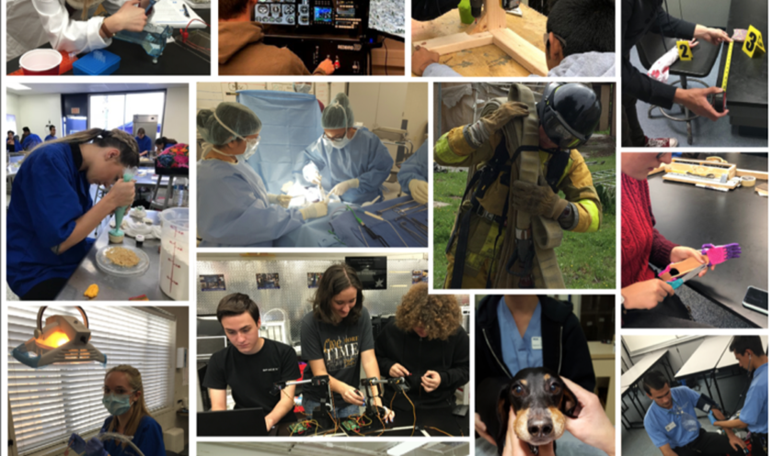
Part 2: Oh Wait! You are a CTE Dean…

Slide 40
What is CTE?
And why do we care?

Slide 41
Economic and Workforce Development
In 1996 EWD became part of CCC statutory mission
California Community Colleges (Education Code 66010.4(a)(3)))
The intent of the Legislature was that the program provide critical support for continuous workforce improvement and economic development, as well as be adaptive and responsive to the changing needs of regional economies
Support the economic growth and global competitiveness of California
Providing skills that are in demand in the job market
Reskilling and upskilling to close skill gaps
Connect workforce with the Job Creators

Slide 42
What is CTE?
Federal Definition:
Providing individuals with the academic and technical knowledge and skills they need to prepare for careers in current or emerging employment sectors.
To put another way:
A broad term for education that combines academic and technical skills with the knowledge and training needed to succeed in today's labor market. CTE prepares students for the world of work by introducing them to workplace competencies in a real-world, applied context.

Slide 43
Examples of CTE Programs…
Accounting, Business Administration, Business Systems & Office Technologies
Agriculture, Farm, and Horticulture
Automotive Technology
Computer Information Systems
Early Childhood Education
Industrial Arts
Health Sciences
Public Safety
Apprenticeship & Pre-Apprenticeship

Slide 44
CTE Programs & Funding Sources
Perkins V
Strong Workforce Programs (SWP)
California Adult Education Program (CAEP)
Apprenticeship
Continuing Education

Slide 45
Perkins
Originally passed as the Vocational Education Act of 1963
Renamed the Carl D. Perkins Act in 1984
It was enacted to increase learner access to high-quality CTE programs of study, especially to those students who had been underserved in the past or who had substantial education needs
The goal was to provide individuals with the academic and technical knowledge and skills they need to prepare for careers in current or emerging employment sectors
It is a principal source of federal funding
The Strengthening Career and Technical Education for the 21st Century Act (Perkins V) was signed into law on July 31, 2018.

Slide 46
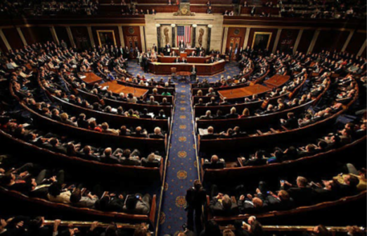
Perkins
Each year under the Perkins statute, Congress appropriates approximately $1.2 billion dollars in State formula grant funds under Title I (Basic State Grants)to develop more fully the academic knowledge and technical and employability skills of secondary and postsecondary education students who elect to enroll in career and technical education programs and programs of study.
The Basic State Grants Program (Title I) are allotted to states through a formula based on populations in certain age groups and earning certain levels of per-capita income
Allocation comes to CDE and CDE disburses the Community College’s share to the Chancellor’s Office
$139M to California

Slide 47
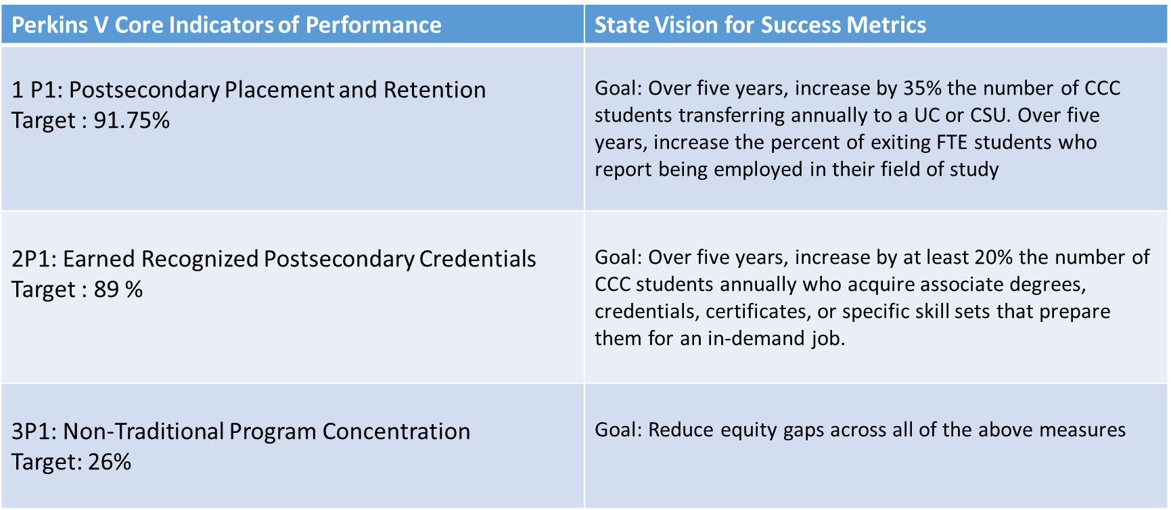
Perkins V Core Indicators

Slide 48
Strong Workforce Program (SWP)
In 2016, Governor and Legislature approved SWP to close the skills gap in California and create 1M middle-skill workers
Original Apportionment $200M
Current Apportionment $290M
Funding formula based on – Unemployment Rate, CTE FTES, and Job Openings
Creating “More and Better” CTE:
“More”: increasing the number of students enrolled
“Better”: improving program quality as evidenced through completion, transfer or employment
Seven key areas targeting: student success, career pathways, workforce data and outcomes, curriculum, CTE faculty, regional coordination and funding

Slide 49
Strong Workforce Program (SWP)
Funding structured: 60% Local Share and 40% Regional Share
Legislation requires collaboration:
Among college districts – 8 Regional Consortia
Industry and Local Workforce Development Boards
Industry Partners
Build on existing partnerships formed in conjunction with WIOA, CAEP, and K-12 CTE programs.

Slide 50
Strong Workforce Program (SWP) – Metrics & Outcomes (Launchboard)
Strong Workforce Program Students
All students who took at least 0.5 units in any single credit course or who had at least 12 positive attendance hours in any noncredit course(s) in the selected year or who enrolled in noncredit course(s) in Spring 2020 or any term in academic year 2021 and who enrolled on a TOP code that is assigned to a vocational industry sector in the selected year
SWP Students Who Earned 9 or More Career Education Units in the District in a Single Year
Among all SWP students, the proportion who successfully completed nine or more career education semester units in the selected year within a single district
SWP Students Who Completed a Noncredit CTE or Workforce Preparation Course
Among all SWP students with a noncredit enrollment on a CTE TOP code or a noncredit enrollment in a workforce preparation course, the proportion who completed a noncredit CTE or workforce preparation course or had 48 or more contact hours in a noncredit CTE or workforce preparation course(s) in the selected year
SWP Students Who Earned a Degree or Certificate or Attained Apprenticeship Journey Status
Number of unduplicated SWP students who earned a noncredit certificate, Chancellor’s Office approved certificate, associate degree, and/or CCC baccalaureate degree on a TOP code assigned to a vocational sector and who were enrolled in the district on any TOP code in the selected year or who attained apprenticeship journey status on a vocationally flagged TOP code in the selected year and who were enrolled at any community college at the start of the apprenticeship program on a vocationally flagged TOP code
SWP Students Who Transferred to a Four-Year Postsecondary Institution
Among SWP students who earned 12 or more units at any time and at any college at any time up to and including the selected year and who exited the community college system, the number of students who enrolled in any four-year postsecondary institution in the subsequent year

Slide 51
Strong Workforce Program (SWP) – Metrics & Outcomes (Launchboard)
SWP Students with a Job Closely Related to Their Field of Study
Among SWP students who responded to the CTE Outcomes Survey and did not transfer to any postsecondary institution, the proportion who reported that they are working in a job very closely or closely related to their field of study
Median Annual Earnings for SWP Exiting Students
Among SWP students who exited the community college system and who did not transfer to any postsecondary institution, median earnings following the academic year of exit
Median Change in Earnings for SWP Exiting Students
Among SWP students who exited and who did not transfer to any postsecondary institution, median change in earnings between the second quarter prior to the beginning of the academic year of entry (for the first time ever as a non-Special Admit or return to any community college after an absence of one or more academic years) and the second quarter after the end of the academic year of exit from the last college attended
SWP Exiting Students Who Attained the Living Wage
Among SWP students who exited college and did not transfer to any postsecondary institution, the proportion who attained the district county living wage for a single adult measured immediately following academic year of exit

Slide 52
California Adult Education Program (CAEP)
Beginning 2015, Governor and Legislature approved the Adult Education Block Grant (currently called the California Adult Education Program – CAEP) allowing more than a million students that enroll in noncredit community colleges and K12 adult education programs an opportunity for moving on to transfer-level coursework and/or the workforce.
Original Apportionment $500M
Current Apportionment $650M
The AB104 legislation Section 84901 (a) specifically states that Adult Education Block Grant Program is to serve adults, and an adult is defined as “a person 18 years of age or older”.
CAEP programs must be aligned with the adult education state priorities: learner transition, program development, equity, leadership, technology and distance learning, program evaluation, and marketing. A
Align with the CCCCO Vision 2030 goals and the CDE Superintendent’s Initiatives
Under EC 84906 (a) (1), as a condition of receipt of an apportionment of funds from this program for a fiscal year, the members of a consortium shall have a consortium-approved three-year adult education plan that addresses a three-year fiscal planning cycle. The plan shall be updated at least once each year (as part of the annual planning process) based on available data pertaining to the requirements of subdivision (b).

Slide 53
California Adult Education Program (CAEP)
Per Education Code Section 84913, CAEP funds are restricted to the following seven program areas:
Elementary and secondary basic skills, including classes required for a high school diploma or high school equivalency certificate;
Programs for immigrants eligible for educational services in citizenship, English as a second language, and workforce preparation;
Programs for adults, including older adults, for entry or reentry into the workforce;
Programs for adults, including older adults, to develop knowledge and skills to assist elementary and secondary school children to succeed academically;
Programs for adults with disabilities;
Short term career technical educational programs with high employment potential;
Programs offering pre-apprenticeship training, in coordination with apprenticeship program(s), as specified.
Funds are distributed by Consortia to the Consortia Members

Slide 54
Apprenticeship
Apprenticeship is a combination of on-the-job training (OJT) and related classroom instruction (RSI) that takes place under the supervision of a journey-level craft person or trade professional, in which workers learn the practical and theoretical aspects of a highly skilled occupation.
Journey-level experience refers to a person who has completed an apprenticeship program or is an experienced worker, not a trainee, and is fully qualified and able to perform a specific trade without supervision.
California has the largest apprenticeship system in the country, with many of the existing programs connected directly with California Community Colleges.
Apprenticeship is a major focus for Governor Newsom with significant funding and program expansions planned.

Slide 55
Continuing Education
Noncredit
CO approved apportionment generating zero-unit courses focused on skill attainment, rather than GPA
Offer a critical entry point for underserved groups of students who aren’t ready for a full for-credit course load, or who need increased flexibility to refresh critical basic skills
No-cost “open access” on-ramp into credit programs for students who are returning to college after time away or who are looking to upskill for increased employment potential
Contract Education
Can be customized and utilized by employers
BTC
Community Education
Classes of Interest – workshops, seminars, excursions
Fee based – Non-apportionment

Slide 56
Part 3: Budget

Slide 57
Types of Funds as Defined in the Budget Accounting Manual
General Funds (10) Restricted (e.g., categorical, grants) and Unrestricted
Debt Service Funds (20)
Special Revenue Funds (30) e.g., Child Development Fund
Capital Projects Funds (40) e.g., Propositions approved by local taxpayers
Enterprise Funds (50) e.g., Bookstore
Internal Service Funds (60) e.g., Liability and Property Insurance
Trust Funds (70) e.g., Financial Aid

Slide 58
General Funds (10) Restricted (e.g., categorical, grants) and Unrestricted
General Fund Unrestricted
Funded through the SCFF – Student Centered Funding Formula
Funds do not carry over to next fiscal year
General Fund Restricted
Restricted for a specific, stated purpose
Example – Strong Workforce Program

Slide 59
Work Plan Development
CTE Proposals – Submitted by Instructional and Non-Instructional programs
Aligns with District Strategic Plan
Advisory Committee support
Included in District Annual Planning process
For SWP
Improve quality and/or quantity of CTE
Encouraged to identify short term workforce training opportunities.
Approved by Dean/Supervisor
Rank proposals - Optional
Determine funding source – SWP, Perkins, or other
Approval from Cabinet level Administrator
Complete Work Plan in NOVA (or applicable portal)

Slide 60
Budget Development
Based on Work Plan
Organized by Object Code (1000,2000,3000…)
Personnel budget projections
Implementation costs
Include Indirect Costs

Slide 61
Budget Tracking
Why use an internal Budget Tracking Spreadsheet?
YTD grant balance clearly visible
District GL system balances may be unreliable
Ability to include projected expenditures
Ability to include Notes to support report preparation

Slide 62
Grant Budgets - Miscellaneous
Carry forward
Chart of accounts
Reimbursement
Link to Introduction to Fiscal Responsibilities by Community College League of California
https://ccleague.org/sites/default/files/images/introtofiscal2023_single_pages.pdf

Slide 63
Part 4: NOVA

Slide 64
NOVA System

Slide 65
Questions?

