Slide 1
CALIFORNIA COMMUNITY COLLEGES
CHANCELLOR’S OFFICE
The Evolution of Career Technical Education at
California’s Community Colleges
Central/Mother Lode Regional Consortium
Regional Planning Conference
June 6th, 2016

Slide 2
Intentions and Updates
Strong Workforce Recommendations
CTE Data Unlocked Initiative Rollout
Strong Workforce Program Funding and Imnplementation

Slide 3
Notes:
Assign lead Vice Chancellor, recognizing that many recommendations cross multiple divisions within the Chancellor’s Office and involves standing bodies across the system

Slide 5
California needs 1 million more AA, certificates, or industry-valued credentials.
#StrongWorkforce
The Goal
Notes:
1 M more middle skill credentials – more than a high school degree but less than a BA. A.k.a., subbaccalaureate: AA, certificates and industry-valued credentials.

Slide 6
Career Technical Education: the Path Out of Poverty
#StrongWorkforce
$60,771
($29.22/hour)
2-parent with
one working adult, 2-child
Source: CA Budget Project
$66,000
AA – Career Technical Education
5-years later
Source: Salary Surfer, 112 CA Community Colleges
$38,500
AA - General Education
5-years later
Source: Salary Surfer, 112 CA Community Colleges
Notes:
Van:
- Our Career Technical Education (CTE) programs have strong earning power, esp given current concerns re: student debt. Actual avg student earnings from our CTE programs 5 years after leaving us is $66K…. Supports a family of 4 to live in CA.

Slide 7
“Some College” is the New Gateway Into The Workforce
#StrongWorkforce
THE LABOR MARKET IS INCREASINGLY DEMANDING A MORE SKILLED WORKFORCE.
IN THE 1970s
IN 1992
BY 2020
of jobs required more than a high school education.
of jobs required more training.
of job openings in the U.S. will require some postsecondary education or training-though not necessarily a four-year degree.
Source: Georgetown Center on Education and the Workforce analysis
4
Notes:
Van:
- “Some College” has become the new gateway for employment. 65% of jobs openings require an AA, certificate, industry-recognized credential or more.

Slide 8
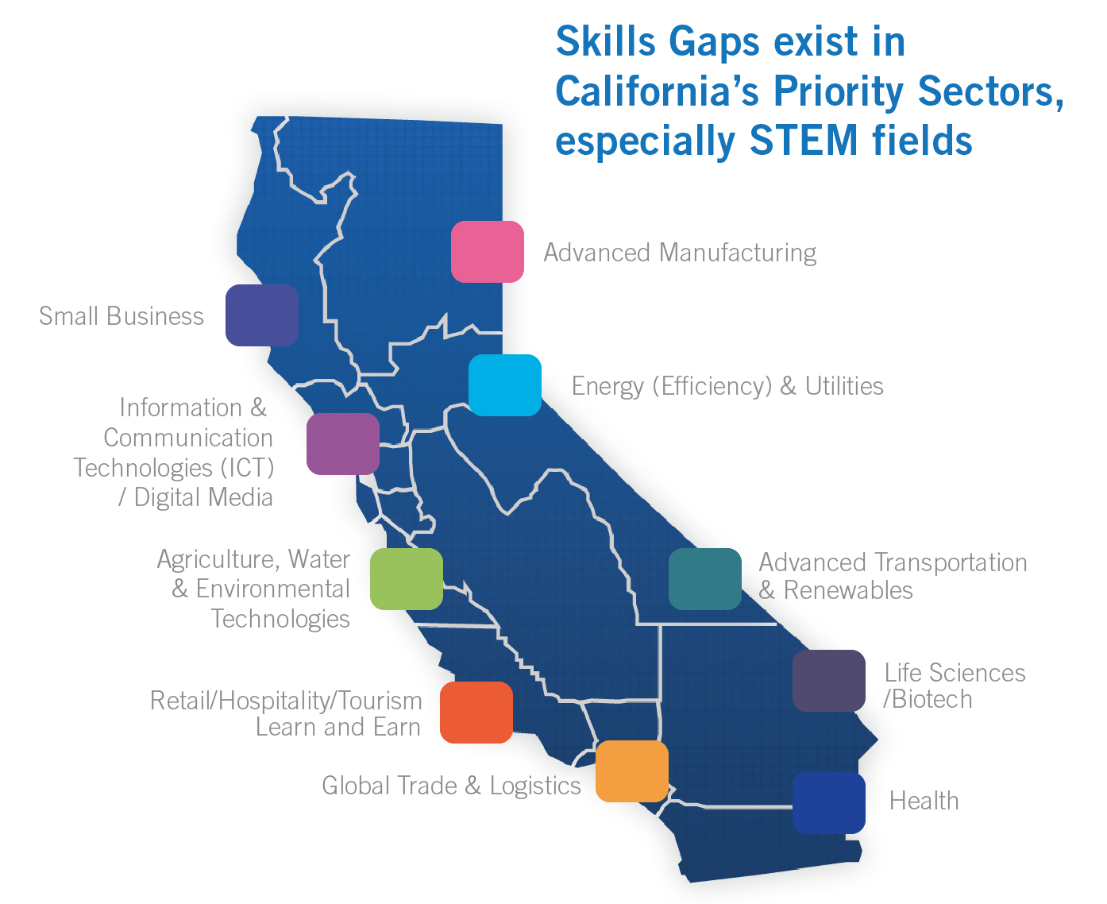
Skill Gaps Differ Across California Regions
Notes:
Van: -
To close this skills gap and get our communities into these jobs, we need to work with the different industry sectors that drive our regional economies.

Slide 9
Central Valley/Mother Lode

Slide 10
Central Valley/Mother Lode

Slide 12
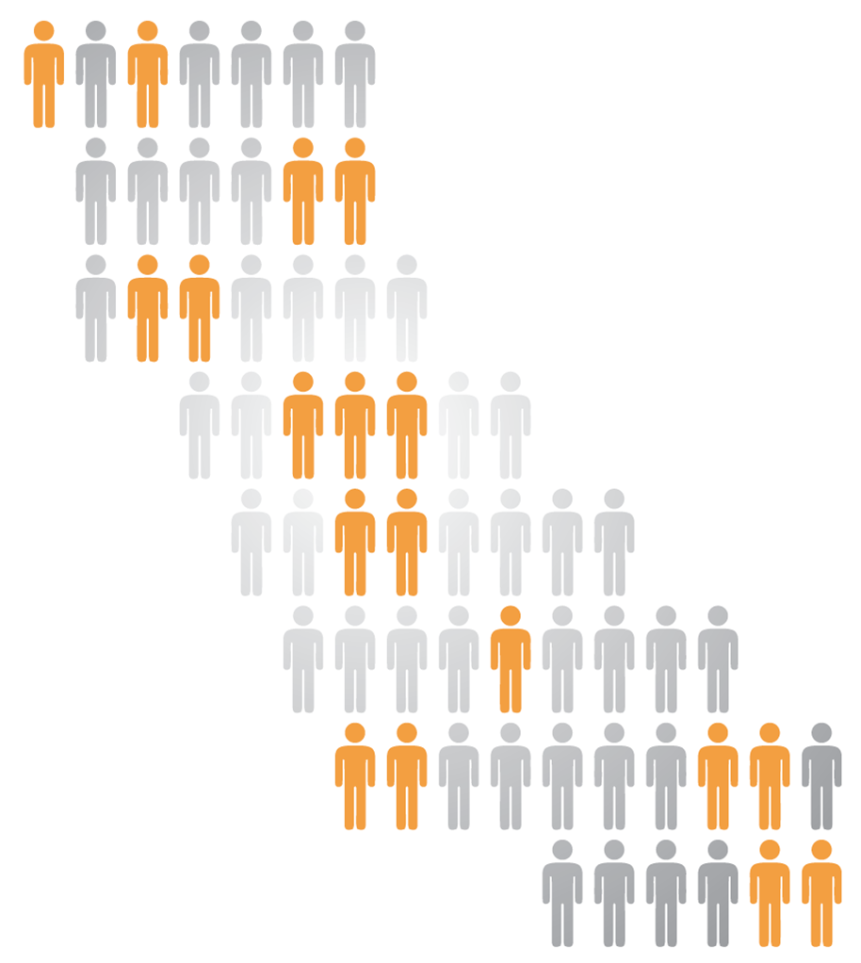
Task Force Roll Out
#StrongWorkforce
14 Regional College & Faculty Conversations
Over 700 attendees, including 40% faculty
6 Strong Workforce Town Hall Meetings
Over 500 participants in regions across the state
6 expert background papers on common themes
Workforce Data & Outcomes
Curriculum Development & Instructors
Structured Pathways and Student Support (2 parts)
Regional Coordination
Funding
5 meetings of the 26-member Task Force
221 website & 10 letters during public comment period
Notes:
-14 Regional College & Faculty Conversations
-5 Town Hall meetings with external stakeholders
- With goal of making recommendations to the Board of Governors in September this year

Slide 13
Strong Workforce Priorities
Student Success
Workforce Data & Outcomes
Curriculum
Career Pathways
CTE Faculty
Regional Coordination
Funding

Slide 14
Recommendations: Student Success
Broaden and enhance career exploration and planning, work-based learning opportunities, and other supports for students.
CCCCO Implementation
Student Success
Task Force
CCCCO Implementation
2011
2012
2013
2014
2015
2016
2017
2018
2019

Slide 15
Recommendations: Workforce Data & Outcomes
Create common workforce metrics for all state funded CTE programs and expand the definition of student success to better reflect the wide array of CTE outcomes of community college students.
Establish a student identifier for high school students and those enrolled in postsecondary education and training programs to enable California to track workforce progress and outcomes for students across institutions and programs. Increase the ability of governmental entities to share employment, licensing, certification, and wage outcome information.
Improve the quality, accessibility, and utility of student outcome and labor market data to support students, educators, colleges, regions, employers, local workforce investment boards, and the state in CTE program development and improvement efforts.

Slide 16
Recommendations: Curriculum
Evaluate, strengthen, and revise the curriculum development process to ensure alignment from education to employment.
Evaluate, revise and resource the local, regional, and statewide CTE curriculum approval process to ensure timely, responsive, and streamlined curriculum approval.
Improve program review, evaluation, and revision processes to ensure program relevancy to both students and business/industry as reflected in labor market data.
Facilitate curricular portability across institutions.
Develop, identify and disseminate effective CTE practices.
Improve CTE student progress and outcomes.
Clarify practices and address issues of course repetition for CTE courses when course content evolves to meet changes in skill requirements.

Slide 17
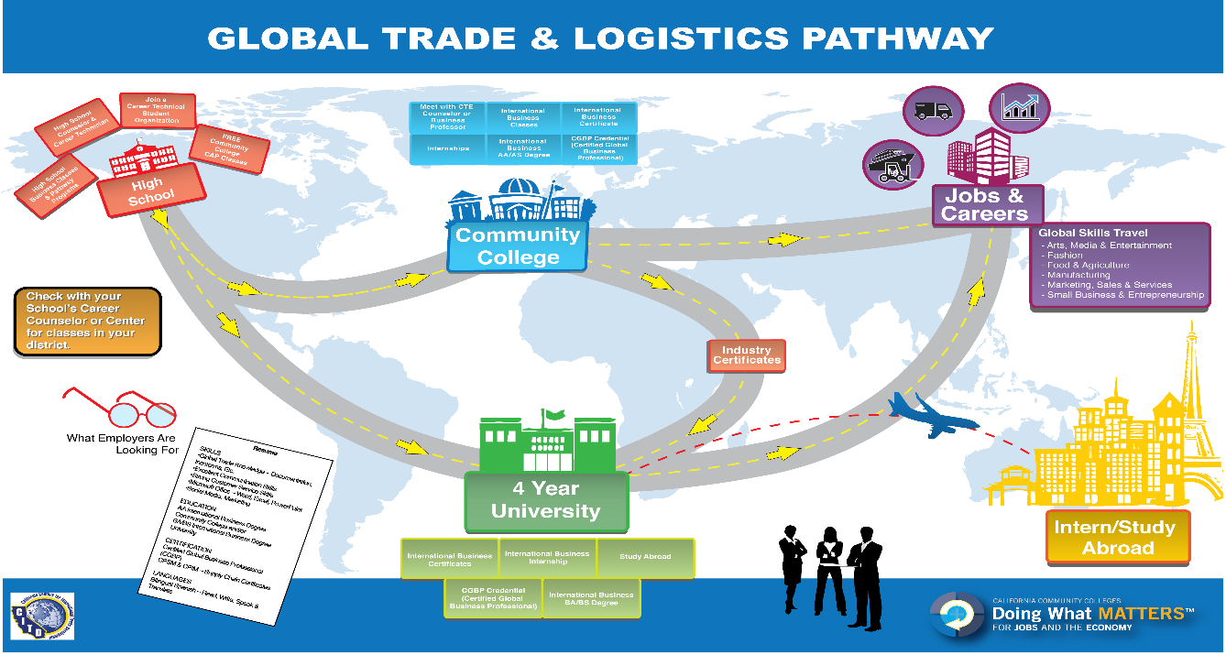
Recommendations: Career Pathways
Develop and broadly publicize industry-informed career pathways that prepare students for jobs needed within the regional labor market.

Slide 18
Recommendations: CTE Faculty
Increase the pool of qualified CTE instructors by addressing CTE faculty hiring practices.
Consider options for meeting minimum qualifications to better integrate industry professionals who possess significant experience into CTE instructional programs.
Enhance professional development opportunities for CTE faculty to maintain industry and program relevancy.
Explore solutions to attract industry professionals in high-salaried occupations to become CTE faculty in community colleges.

Slide 19
CTE Data UNLOCKED

Slide 20
Recommendations: Regional Coordination
Strengthen communication, coordination and decision-making between regional CTE efforts and the colleges to meet regional labor market needs.
Clarify and modify, as needed, state regulations to allow colleges to regionalize course articulation along career pathways utilizing regional or state curriculum models.
Develop regional leadership and operational partnerships among community college, industry, labor, and other workforce and economic development entities to improve the delivery of all CTE efforts.
Develop robust connections between community colleges, business and industry representatives, labor and other regional workforce development partners to align college programs with regional and industry needs and provide support for CTE programs.
Create a sustained, public outreach campaign to industry, high school students, counselors, parents, faculty, staff, and the community-at-large to promote career development and attainment and the value of career technical education.

Slide 21
CTE DATA Unlocked
Response to Recommendations in Strong Workforce Task Force to:
Improve the quality, accessibility and utility of student outcome and labor market data
Support career and technical education program development and improvement efforts
Provide a suite of tools, training, technical assistance and funding to support this goal

Slide 22
2014-15
2016 Q1-2
2016 Q3-4
2017
2018
Free the data
Train on tools
CTE Data Unlocked
Invest Strong Workforce $200M
Scale
Excellence
Build & QA
the
LaunchBoard data tool
Train 113 colleges & key talents to use
LaunchBoard
Regional Labor Market Gap
Train the trainer
Train expert users
Train campus teams & regional teams
Input from WIOA & industry partners, etc,
Deep Dive into Data by Campus
Deep Dive into Data by Region
Notes:
UP TO $50K PER CAMPUS ONCE THEY HAVE UNDERGONE INITIAL TRAINING
Integrated Launchboard data into campus planning
Deep dive TA to understand your data
Train CTE faculty on the launchboard
Clean up data
Other

Slide 23
Recommendations: Workforce Data & Outcomes
Create common workforce metrics for all state funded CTE programs and expand the definition of student success to better reflect the wide array of CTE outcomes of community college students.
Establish a student identifier for high school students and those enrolled in postsecondary education and training programs to enable California to track workforce progress and outcomes for students across institutions and programs. Increase the ability of governmental entities to share employment, licensing, certification, and wage outcome information.
Improve the quality, accessibility, and utility of student outcome and labor market data to support students, educators, colleges, regions, employers, local workforce investment boards, and the state in CTE program development and improvement efforts.

Slide 24
CTE Data Unlocked Initiative
Provides tools, training, technical assistance, and funding to support better use of CTE outcomes data and labor market information
Supports the development of regional workforce plans
Prepares for $200 million in new CTE funding that will be available in 2017
Strengthens ongoing capacity for CTE data usage in program review, accreditation, integrated planning, and regional and sector-based program design

Slide 25
Broad-Based Partnership
California Community Colleges Chancellor’s Office
Academic Senate for California Community Colleges
Centers of Excellence
CTE Outcomes Survey/Santa Rosa Junior College
Delta College/Educational Results Partnership/Butte CCD
Institutional Effectiveness Partnership Initiative
Regional Consortia Chairs
RP Group
Sector Navigators
WestEd/Butte CCD

Slide 26
Building Awareness (Spring 2016)
Provide an overview on CTE data at regional trainings:
learn about the expanded CTE metrics on the Student Success Scorecard
get hands-on experience with statewide tools like Salary Surfer, Data Mart, and the LaunchBoard
send a team including a senior administrator (CEO, CIO, or CSSO), plus one or more CTE deans, faculty, and institutional researchers

Slide 27
Deepening Expertise (Summer 2016)
Build system-wide capacity to find, understand, and use data:
provide training for Chancellor’s Office technical assistance providers on how to use CTE data tools and labor market information
release resources to support colleges in integrating these data sources into college processes such as program review, accreditation, and integrated planning

Slide 28
Resource Examples
How to use data tools in various usage cases such as program review, accreditation, and planning, offered in various formats including:
Two minute videos
Seven page guides
Detailed how-to guides
Animated PowerPoints
Short document on how to analyze and work with metrics such as employment and earnings data and labor market information

Slide 29
Expanding Regional Data Use (Fall 2016)
Support the development of regional workforce plans:
release regional reports that integrate labor market information and student outcomes data from Data Mart, the LaunchBoard, the CTE Employment Outcomes Survey, and other sources
host meetings with colleges, employers, and other educational partners to create regional workforce plans

Slide 30
Supporting College Data Usage (2016-2017)
Support colleges in integrating regional plans and CTE data into core activities:
offer $50,000 in funding and 10 hours of technical assistance to support CTE data usage (for colleges that attended spring training)
host in-depth “super-user” trainings to help practitioners develop a deeper understanding of CTE data tools and labor market information.
provide one free year of participation in the CTE Outcomes Survey (tracks employment and other post-college outcomes)
roll out three years of participation in the CATEMA system (tracks participation in articulated courses and eligibility for credit)

Slide 31
Technical Assistance Examples
Onsite training with student services professionals, faculty, and deans on using employment data for educational planning and to strengthen support services
Onsite training with a specific department or program, where participants examine outcomes in various statewide data tools
Hands-on support to pull and format data from statewide data tools to support local and regional processes like program review, accreditation, and planning
Technical support to examine TOP code assignments and identify data points that are missing from the LaunchBoard, leading to recommendations on how to improve data quality in statewide tools

Slide 32
Funding Examples
Hire a communications consultant to develop outreach and educational planning materials based on data found in the LaunchBoard, Salary Surfer, and other tools
Hire a consultant or pay faculty release time to gather stories on skills-builder students and analyze skills-builder pathways, to provide a deeper understanding of these students, course clusters, and outcomes
Support integration of the CATEMA system, including faculty stipends to support the development of processes with K-12 partners and A&R offices to gather and process information on articulated courses and credit by exam
Improve response rates for the CTE Outcomes Survey, such as purchasing services that can provide updated contact information for former students or providing faculty stipends to develop communications plans to clarify the importance of the survey to students

Slide 33
Strong Workforce Trailer Bill
Focused on quality of programs and quantity of students
Overarching emphases:
Regional Collaboration and Planning
Alignment of efforts
Reduction of duplication
Regional plus local needs

Slide 34
Strong Workforce Trailer Bill: Funding
Statewide coordination: 5%
Regionally Prioritized Programs: 40%
Local Programs: 60%
Up to 60% of which can be spent on maintenance
Supplementing not supplanting

Slide 35
Strong Workforce Trailer Bill: Funding
Future allocations shall be based on:
A baseline where percentage of CTE courses increases or remains the same
Later allocations on:
Unemployment rate
Percentage of CTE students
Projected job openings
Performance relative to WIOA metrics

Slide 36
Contact Information
Walter Di Mantova
Dean, Workforce Development
California Community College Chancellor’s Office
916.327.1260
wdimantova@gmail.com

