Slide 1
25 STRONG WORKFORCE RECOMMENDATIONS
IMPLEMENTATION OVERVIEW
#strongworkforce
DoingWhatMATTERS.cccco.edu

Slide 2
California needs 1 million more AA, certificates, or industry-valued credentials.
#StrongWorkforce
The Goal
Notes:
1 M more middle skill credentials – more than a high school degree but less than a BA. A.k.a., subbaccalaureate: AA, certificates and industry-valued credentials.

Slide 3
“Some College” is the New Gateway Into The Workforce
#StrongWorkforce
THE LABOR MARKET IS INCREASINGLY DEMANDING A MORE SKILLED WORKFORCE.
IN THE 1970s
IN 1992
BY 2020
of jobs required more than a high school education.
of jobs required more training.
of job openings in the U.S. will require some postsecondary education or training-though not necessarily a four-year degree.
Source: Georgetown Center on Education and the Workforce analysis
4
Notes:
“Some College” has become the new gateway for employment. 65% of jobs openings require an AA, certificate, industry-recognized credential or more.

Slide 4
Career Technical Education: The Path Out of Poverty
#StrongWorkforce
$60,771
($29.22/hour)
2-parent with
one working adult, 2-child
Source: CA Budget Project
$66,000
AA – Career Technical Education
5-years later
Source: Salary Surfer, 112 CA Community Colleges
$38,500
AA - General Education
5-years later
Source: Salary Surfer, 112 CA Community Colleges
Notes:
Our Career Technical Education (CTE) programs have strong earning power, esp given current concerns re: student debt. Actual avg student earnings from our CTE programs 5 years after leaving us is $66K…. Supports a family of 4 to live in CA.

Slide 5
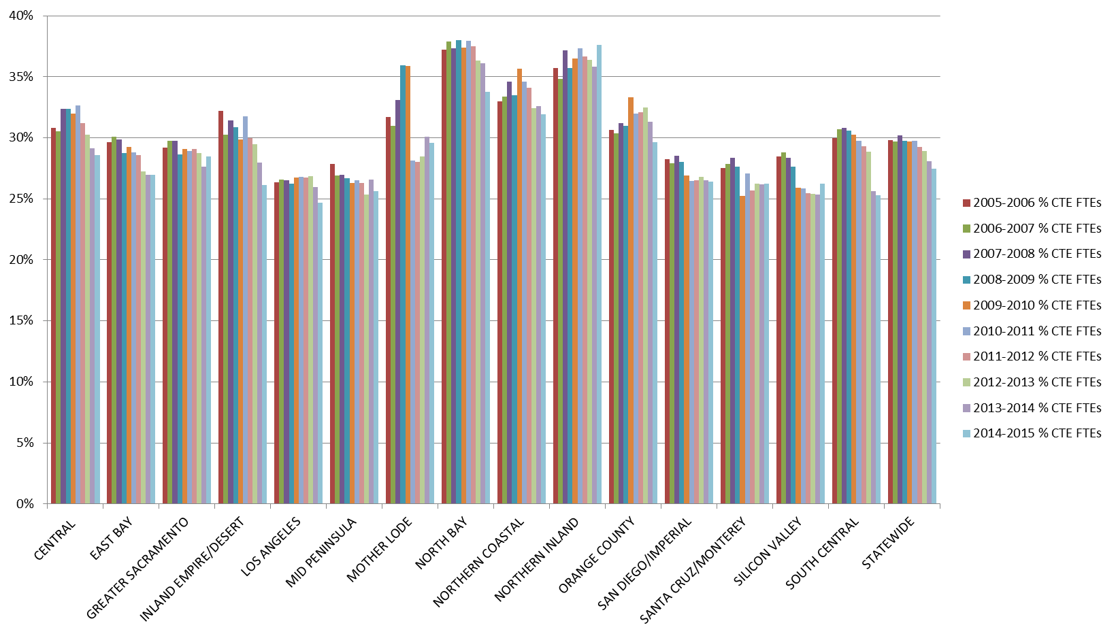
Cost Creates Disincentive to Offer CTE 10-year trend in CTE portfolio of community colleges (as % of Full Time Equivalent Students)

Slide 6
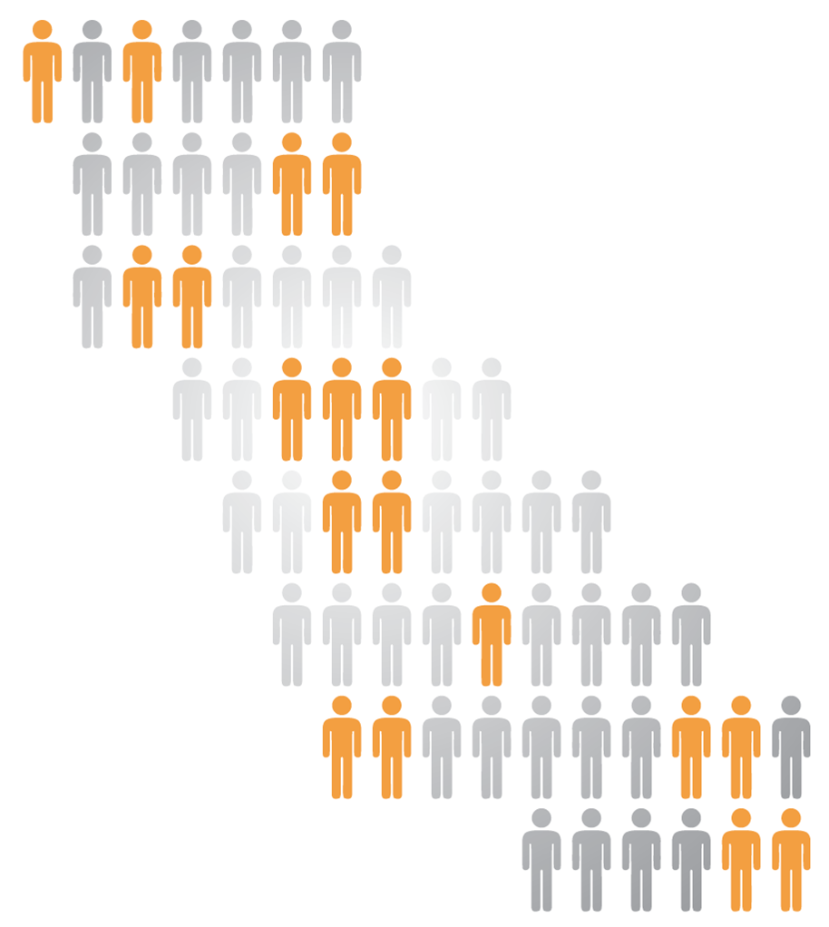
Input into Strong Workforce
#StrongWorkforce
14 Regional College & Faculty Conversations
Over 700 attendees, including 40% faculty
6 Strong Workforce Town Hall Meetings
Over 500 participants in regions across the state
6 expert background papers on common themes
Workforce Data & Outcomes
Curriculum Development & Instructors
Structured Pathways and Student Support (2 parts)
Regional Coordination
Funding
5 meetings of the 26-member Task Force
221 website & 10 letters during public comment period
Notes:
-14 Regional College & Faculty Conversations
-5 Town Hall meetings with external stakeholders
- With goal of making recommendations to the Board of Governors in September this year

Slide 7
25 Strong Workforce Recommendations Adopted by the Board of Governors in Fall 2015
#1-2 Student Success
#3 Career Pathways
#4-6 Workforce Data & Outcomes
#7-12 Curriculum
#13-16 CTE Faculty
#17-20 Regional Coordination
#21-25 Funding
Notes:
-14 Regional College & Faculty Conversations
-5 Town Hall meetings with external stakeholders
- With goal of making recommendations to the Board of Governors in September this year

Slide 9
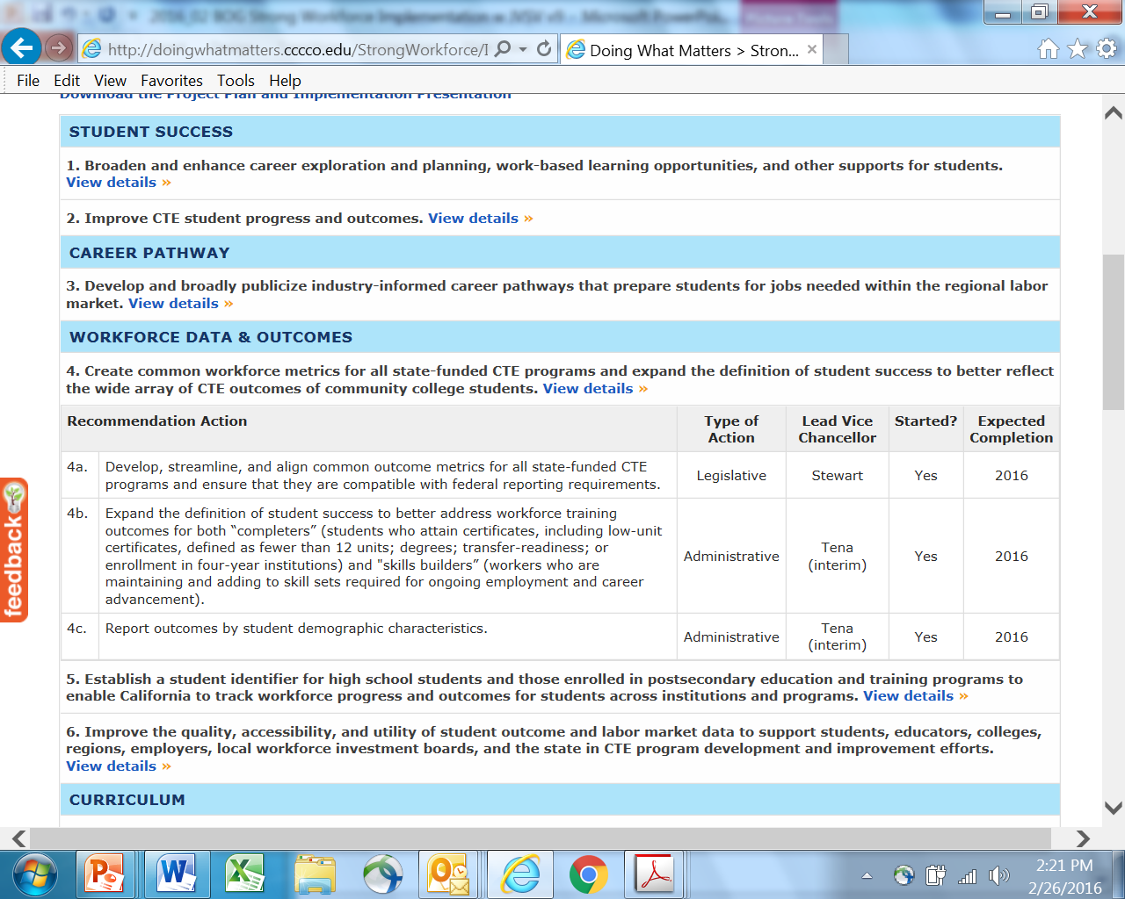
CLICK TO EXPAND

Slide 10
Legislative & Budget Actions:
Senate Bill 66 (Leyva) – data sharing
Assembly Bill 1892 (Medina) – CalGrant C financial aid
Governor’s Proposed 2016-17 Budget - $200M
Notes:
Assign lead Vice Chancellor, recognizing that many recommendations cross multiple divisions within the Chancellor’s Office and involves standing bodies across the system

Slide 11
Support SB 66 - Leyva
ANALYSIS:
Existing federal law, the Workforce Innovation and Opportunity Act (WIOA) reauthorizes the nation's employment, training, adult education, and vocational rehabilitation programs created under the Workforce Investment Act of 1998. WIOA, among other things, requires states to strategically align workforce development programs, promote accountability and transparency and foster regional collaboration. (Title 29 United States Code, Chapter 32, § 3101, et seq.) SB 66 Page 2
Existing state law:
1) Establishes the California Community Colleges Economic and Workforce Development (EWD) Program to be implemented and administered by the Chancellor’s Office of the CCC in those fiscal years for which funds are appropriated for this purpose.
2) Requires the Chancellor to implement performance accountability outcome measures to annually provide the Governor, Legislature, and public with information that quantifies employer and student outcomes for program participants. (Education Code § 88600, § 88650)
This bill:
1) Requires the Department of Consumer Affairs (DCA) to make available any licensure information it has in electronic format for its boards, bureaus, commissions, or programs to the CCC Chancellor’s Office to enable the CCC to:
a) Measure employment outcomes of students who participate in CCC career technical education programs.
b) Recommend improvements in CCC career technical education programs.
2) Authorizes DCA to make available the confidential information outlined in (1) only to the extent that such disclosure is in compliance with state and federal privacy laws.
3) Requires, to the extent possible, the alignment of performance accountability outcome measures for the economic and workplace development program with the performance accountability measures of the federal WIOA. It also:
a) Deletes existing statutorily prescribed performance measures.
b) Reduces data collection requirements.

Slide 12
Support AB 1892 - Medina
ANALYSIS:
Fees are waived for Cal Grant recipients attending a California community college. For Cal Grant C recipients, the award provides $547 per year for career technical education and training related costs such as special clothing, transportation, tools and equipment, supplies, textbooks, housing and food. These costs are defined in statute as access costs.
In 2006 a student survey conducted by California Student Aid Commission showed the average cost of books and supplies was $795 per term. The Cal Grant C award ,like many other financial aid programs, has not kept pace with cost of living increases over time.
Existing state law:
Establishes the California Student Aid Commission for purposes of administering Cal Grant student aid programs. (Education Code § 66900).
Cal Grant C awards may be used for institutional fees and tuition ($2,462) and access costs ($547) for occupational or technical training in a course of not less than 4 months. (Education Code § 69439).
The program requires the commission to give priority in granting Cal Grant C awards to students pursuing occupational or technical training in areas that meet high wage and high need criteria. (Education Code § 69439).
Major provisions of the bill would:
establish a community college supplemental award of $2,462 for the competitive Cal Grant C program to help community college students pay for access costs;
establish an entitlement Cal Grant C program exclusively for community college students pursing certificate programs of less than one year (less than 24 semester units or 36 quarter units) in high wage and high need areas.
set the entitlement award at $3,000;
require a 2.0 GPA from high school to be eligible for the entitlement award;
establish a 3-year gap period between high school graduation and enrollment at a community college for purposes of maintaining eligibility to apply for an entitlement award; and
extend the Cal Grant application deadline to Sept. 2.
AB 1892 would establish an entitlement Cal Grant C program that compliments the current competitive Cal Grant C program. Both award programs focus on students pursuing high wage and high need careers. Major provisions of the bill include:
Competitive: 1) establishes a community college supplemental Cal Grant C award of $2,462 to help pay for access costs, i.e. books, housing, food , transportation, equipment/tools, and special clothing and fees. 2) The number of awards is maintained at current level—7,761.
Entitlement: 1) creates a Cal Grant C access award of $3,000; 2) requires a 2.0 GPA from high school; provides a 3-year gap period between high school and a community college; is available for CTE certificate programs of less than one year, (less than 24 semester units or 12 quarter units).

Slide 13
Last time: $50M CTE Enhancement Fund
Regional Labor Market Analysis
Regionally-Prioritized Projects/
Programs
Input from regional industry partners, etc,
Locally Prioritized Campus Planning
Locally Prioritized Campus Planning
Locally Prioritized Campus Planning
Locally Prioritized Campus Planning
Locally Prioritized Campus Planning
Locally Prioritized Campus Planning
Locally Prioritized Campus Planning
Locally Prioritized Campus Planning
Locally Prioritized Campus Planning
Locally Prioritized Campus Planning
Locally Prioritized Campus Planning
113 Locally Prioritized Campus Planning

Slide 14
Preparing for the $200M
2014-15
2016 Q1-2
2016 Q3-4
2017
2018+
Free the data
Train on tools
CTE Data Unlocked
Invest Strong Workforce $200M
Scale
Excellence
Build & QA
the
LaunchBoard data tool
Train 113 colleges & key talents to use
LaunchBoard
Regional Labor Market Gap
?
Budget
Trailer Bill Language
Specifies how funds
will be used
Timing:
Proposed Language (1/16)
“May Revise” Language (5/16)
Final Language (7/16)
Allocations Modelled (8/16)
BOG Approval (9/16)
Regional Planning (Fall/16)
Regional Plans Due (1/17)
WIOA State Plan to Feds (4/17)
Train the trainer
Train expert users
Train campus teams & regional teams
Input from WIOA & industry partners, etc,
Deep Dive into Data by Campus
Deep Dive into Data by Region
Notes:
UP TO $50K PER CAMPUS ONCE THEY HAVE UNDERGONE INITIAL TRAINING
Integrated Launchboard data into campus planning
Deep dive TA to understand your data
Train CTE faculty on the launchboard
Clean up data
Other

Slide 15
Trailer Bill Language (1/16 version) Strong Workforce Program 54.5; Section 88821
Expanding the availability of quality CTE
Courses, programs, pathways, credentials, certificates, degrees
Evidence based decision-making
Student success with workforce outcomes aligned to WIOA
Expand on CTE Regional Consortia infrastructure
Coordinate and align within region
WIOA / CA State Plan
Collaborate with K12, local workforce boards, economic development/industry/labor/civic, interested public 4-year, adult education

Slide 16
CCCCO to Implement Policies/Guidance by June 30, 2017
Facilitate regional development, implementation, and sharing of
CTE effective practices (e.g., Professional Development Portal, DWM Practices with Promise)
Curriculum models, courses, credentials, certificates, degrees, and programs across regions and between colleges (a.k.a., curriculum portability)
Enable districts to develop quality CTE
Example: Stand alone course approval policy
Provide performance and labor market data for regional planning
Example: Launchboard 2.0; CTE Data Unlocked
Local efficiency through coordinated regional efforts
Efficiently Transfer CTE credits across CCs, CSU, UC (a.k.a., student portability)

Slide 17
Policies/Guidance…by June 30, 2017
Improve sector-based engagement w employers in a region & secure work-based learning (WBL) to improve employability of students
Enable districts to regionally support Strong Workforce Program & use dollars for student success with workforce outcomes
Streamline course and curriculum approval both at state and local levels, including potential elimination of a state approval process for CTE
Eliminate barriers to hiring qualified CTE instructors, including re-evaluating the required minimum qualifications

Slide 18
To Receive Funds…
Regional Plans:
Name of entities and designated fiscal agent
Governance model – but decisions on these dollars shall be determined exclusively by participating CC districts. Dollars go to district from the fiscal agent
Analysis of regional labor market needs & wage
Prioritized projects: regional & local
For regional projects: work plan, spending plan, budget
Measurable goals that align with WIOA performance measures
Alignment of pathways and workforce sector strategies within region
Must participate
In regional (WIOA) planning
Be a member
of the regional collaborative
Full regional plans due by 1/17
4-year WIOA planning cycle w CCCCO reviewing plans every 4 years and providing technical assistance
Annual updates
Posted by CCCCO to web
Districts shall utilitize
their region’s plan to inform
local campus planning efforts
CTE courses, programs, pathways
Funds supplement not supplant
Provide performance data
by demographics

Slide 19
CCs Must Certify Their Use of Funds to Accomplish…
Increase number of students in quality CTE courses, programs, pathways that lead to successful workforce outcomes; OR invest in new or emerging CTE likely to lead to successful workforce outcomes
Address recommendations from Strong Workforce Task Force including provision of student services related to career exploration, job readiness, placement, work-based learning (WBL)

Slide 20
5% of Funds
Statewide activities to improve and administer program
System, program and data alignment at state and regional level
Development and maintenance of cross-system data reporting mechanism
Research, evaluation, and technical assistance
Prototyping of innovative policies and practices, coordinated services w/ workforce and education partners
Coordinated cross agency training of local program staff

Slide 21
Factors Determining Regional Allocation
Regional collaborative shall allocate funds in accordance
with its plan only to cc districts for use by their colleges
2016-17…
+ Unemployment
+ CTE FTES
+ Projected job openings
2017-18 … also invites interested 4-year institutions into regional planning
+ Unemployment
+ CTE FTES
+ Projected job openings
+ Proportion of successful workforce outcomes based on WIOA measures

Slide 22
Your Feedback
Options for providing some funding predictability for colleges (e.g., local vs. regional shares)?
Decision-makers (colleges vs districts) vs. advisors (K12, interested public 4-years, civic, industry, local workforce board, etc.)?
Factors determining funding allocation?
Practicality of “workplan, spending plan, budget submission” by Jan 31st every year? Synching with WIOA regional planning.
Incorporation of regional set asides?
To fund program start up funds to take risk off of an individual college?
If a region wants to pilot in competency based-ed?
For outreach?
Crosswalk of CTE Regional Consortia vs. LWIB Regional Planning Units? What to do if a college is straddling two boundaries.
Other

Slide 23
APPENDIX

Slide 24
STUDENT SUCCESS
Broaden and enhance career exploration and planning, work-based learning opportunities, and other supports for students. | Administrative Budget
2. Improve CTE student progress and outcomes. | Administrative Regulatory
CAREER PATHWAY
Develop and broadly publicize industry-informed career pathways that prepare students for jobs needed within the regional labor market. | Administrative
WORKFORCE DATA & OUTCOMES
Create common workforce metrics for all state-funded CTE programs and expand the definition of student success to better reflect the wide array of CTE outcomes of community college students. | Administrative Legislative
Establish a student identifier for high school students and those enrolled in postsecondary education and training programs to enable California to track workforce progress and outcomes for students across institutions and programs. | Administrative Legislative
Improve the quality, accessibility, and utility of student outcome and labor market data to support students, educators, colleges, regions, employers, local workforce investment boards, and the state in CTE program development and improvement efforts. | Administrative

Slide 25
CURRICULUM
Evaluate, strengthen, and revise the curriculum development process to ensure alignment from education to employment. | Administrative Regulatory
Evaluate, revise and resource the local, regional, and statewide CTE curriculum approval process to ensure timely, responsive, and streamlined curriculum approval. | Administrative
Improve program review, evaluation, and revision processes to ensure program relevance to students, business, and industry as reflected in labor market data. | Administrative
Facilitate curricular portability across institutions. | Administrative Regulatory
Develop, identify and disseminate effective CTE practices. | Administrative
Clarify practices and address issues of course repetition for CTE courses when course content evolves to meet changes in skill requirements. | Administrative Legislative

Slide 26
CTE FACULTY
Increase the pool of qualified CTE instructors by addressing CTE faculty recruitment and hiring practices. | Administrative
Consider options for meeting minimum qualifications to better integrate industry professionals who possess significant experience into CTE instructional programs. | Administrative Regulatory
Enhance professional development opportunities for CTE faculty to maintain industry and program relevance. | Administrative Regulatory
Explore solutions to attract industry professionals in high-salaried occupations to become CTE faculty in community colleges. | Administrative

Slide 27
REGIONAL COORDINATION
Strengthen communication, coordination, and decision-making between regional CTE efforts and the colleges to meet regional labor market needs. | Administrative
Clarify and modify, as appropriate, state regulations to allow colleges to regionalize course articulation along career pathways utilizing regional or state curriculum models. | Regulatory
Develop regional leadership and operational partnerships among community college, industry, labor, and other workforce and economic development entities to improve the delivery of all CTE efforts. | Administrative Budget
Develop robust connections between community colleges, business and industry representatives, labor and other regional workforce development partners to align college programs with regional and industry needs and provide support for CTE programs. | Administrative

Slide 28
FUNDING
Create a sustained, public outreach campaign to industry, high school students, counselors, parents, faculty, staff, and the community at large to promote career development and attainment and the value of career technical education. | Budget
Establish a sustained funding source to increase community colleges’ capacity to create, adapt, and maintain quality CTE courses and programs that are responsive to regional labor market needs. | Budget
Create a predictable, targeted, and sustained funding stream that leverages multiple local, state, and federal CTE and workforce funds to support an infrastructure for collaboration at the state, regional and local levels; establish regional funding of program start-up and innovation; and develop other coordination activities. | Budget
Review, analyze, and modify, as needed, laws and regulations related to student fees for disposable and consumable materials and CTE facilities. | Budget Legislative
Create incentives and streamline processes to maximize public and private investment in support of CTE programs. | Administrative Legislative

