Slide 1
Cyberpatriots = FTES + Certifications + Jobs
Tim Woods and Dennis Mohle
June 14, 2017
Monterey, CA

Slide 2
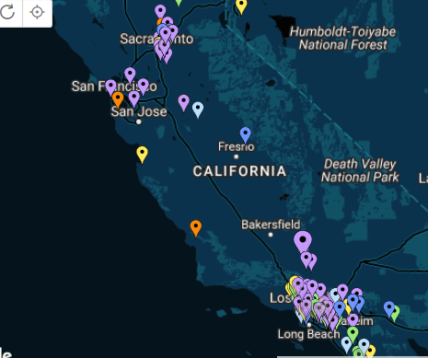
Cyberpatriots = FTES + Certifications + Jobs
Background
CyberPatriot teams registered for CP X competition
Source: www.uscyberpatriot.org

Slide 3
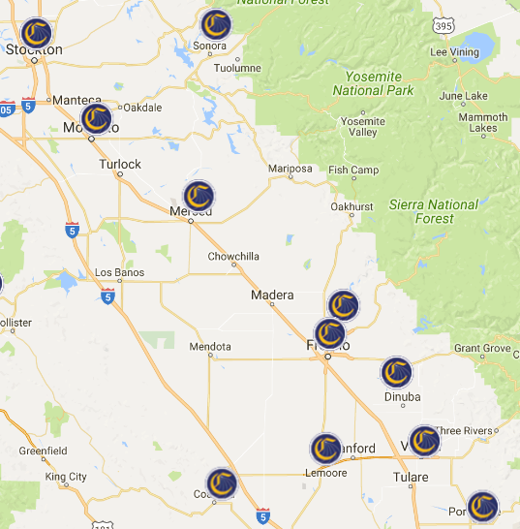
Cyberpatriots = FTES + Certifications + Jobs
Background
CompTIA A+ Classes at Regional Colleges

Slide 4
Cyberpatriots = FTES + Certifications + Jobs
Background
CompTIA+ Certification
Source: www.certification.comptia.org

Slide 5
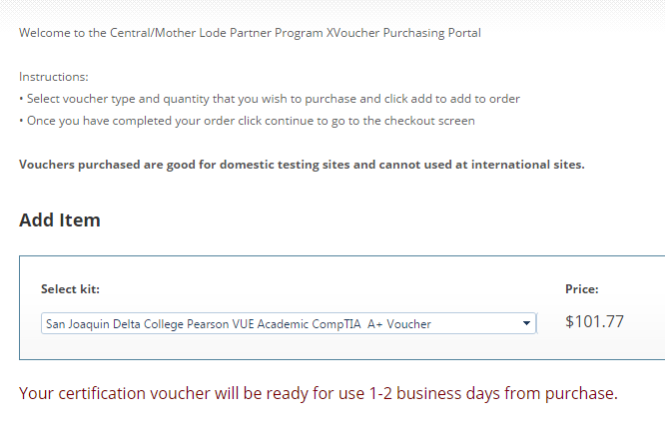
Cyberpatriots = FTES + Certifications + Jobs
Get Certified
Xvoucher
Regional Testing Center ??

Slide 6
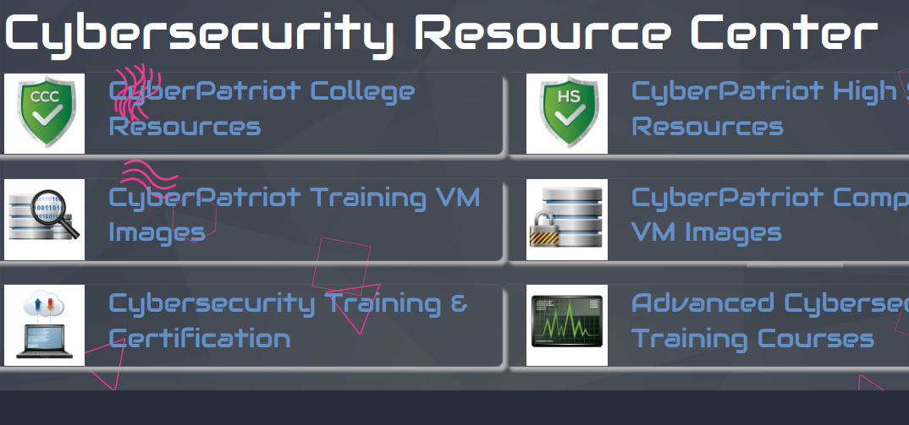
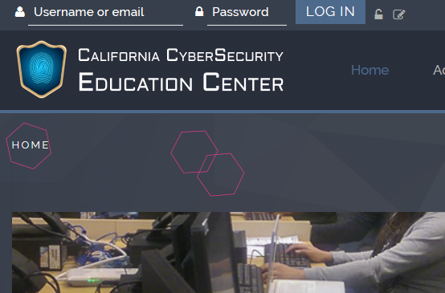
Cyberpatriots = FTES + Certifications + Jobs
ICT Sector Help

Slide 7
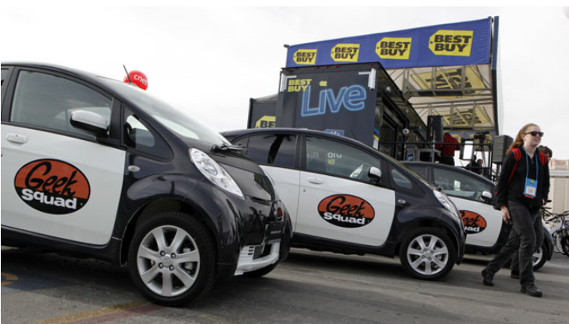
Cyberpatriots = FTES + Certifications + Jobs
Get Employed
Source: www.twincities.com
Source: tkscomputersolutions.com
Source: www.getty-images.com

Slide 8
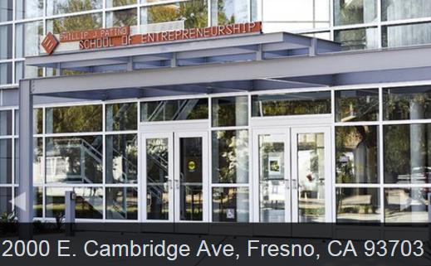
Cyberpatriots = FTES + Certifications + Jobs
Pilot Program
Patino High School and Cerro Coso College

Slide 9
Cyberpatriots = FTES + Certifications + Jobs
Goals
50 teams in the region
40% enroll in online or F2F classes (50 x 5 x .4 = 100)
70% complete the course
50% take a certification exam
40% pass the exam
25% get jobs
= 25 part-time jobs in the central region

Slide 10
Cyberpatriots = FTES + Certifications + Jobs
Price tag (based on 50 teams)
$1,000 coach stipend per team $50,000
$180 registration per team $9,000
Three Raspberry Pi Kits (Pi + Micro SD card + cables) 75 x 3 x 50 $11,250
Total cost for 50 teams = $70,250

Slide 11
Cyberpatriots = FTES + Certifications + Jobs
Questions?
Tim Woods
tim.woods@fresnocitycollege.edu
Dennis Mohle
dennis.mohle@fresnocitycollege.edu

