Slide 1
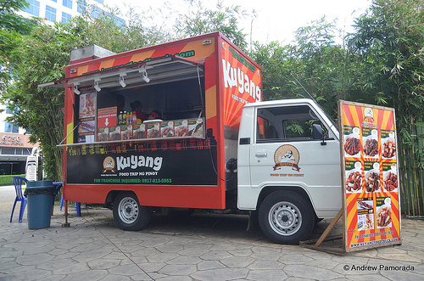
Welcome to the Gig Economy
Central Valley / Motherlode Region
Counselors Conference
September 14, 2018

Slide 2
WORKING IN A GIG ECONOMY
By 2020, 43 percent of the American workforce, will be freelancers, contractors and temp workers.
Source: Intuit 2020 Report

Slide 3
Self-employment Pathways in the Gig Economy 2018 Pilot
26 California community colleges - 3 components
Entrepreneurship / Business course
Working in a Gig Economy course components
Mentoring / Shared Space Tracking software

Slide 4
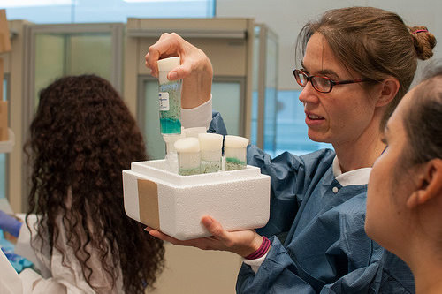
Linking Advising to the Classroom
2 Community Colleges in the CVML Region in Pilot
Across Disciplines
Entrepreneurial Mindset
Linking internship and real life job experience

Slide 5
GIG ADVANTAGES
Do Something You Love!
Be Your Own Boss!
Flexible!
Own Your Future!

Slide 6
doingwhatmatters.cccco.edu

Slide 7
Professional Development Resources
www.eshipeducator.com
Review & Rate Curriculum/Resources
Upload & Download Curriculum/Resources
www.entrepreneurcurriculum.com
Ice House Training
Michaelson Foundation – patents, copyright
Community of Practice sessions
doingwhatmatters.cccco.edu

Slide 8
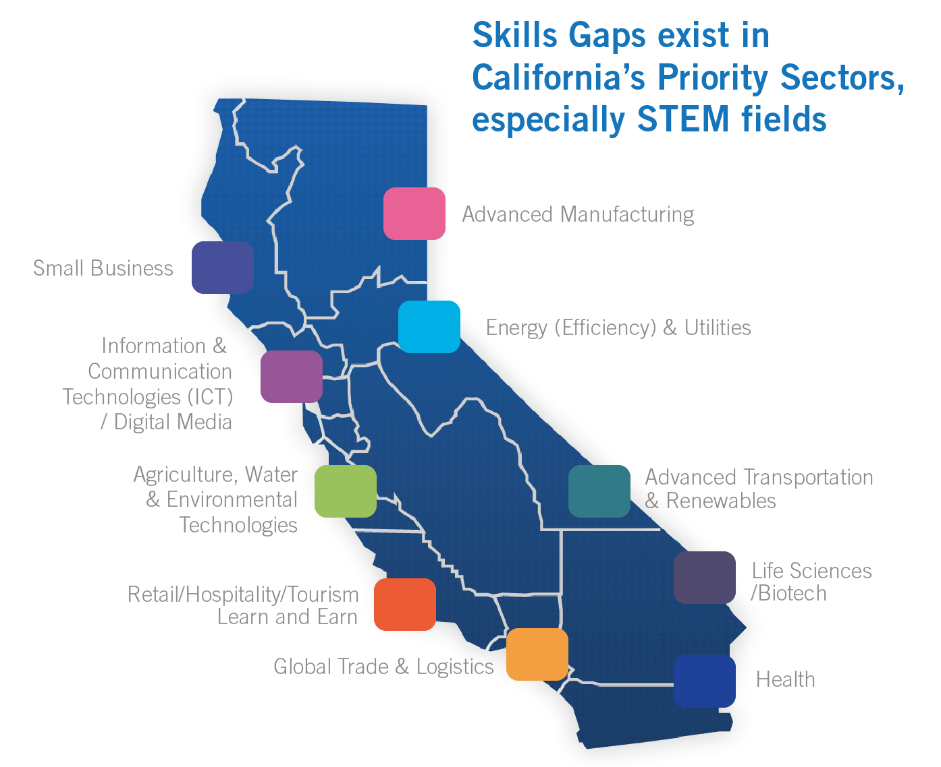
doingwhatmatters.cccco.edu

Slide 9
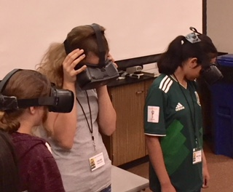
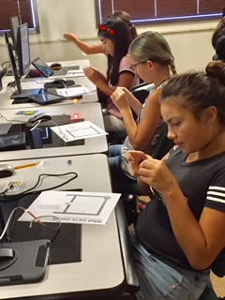
3D Printing
Coding
Virtual Reality
Design Thinking/Entrepreneurship

Slide 10
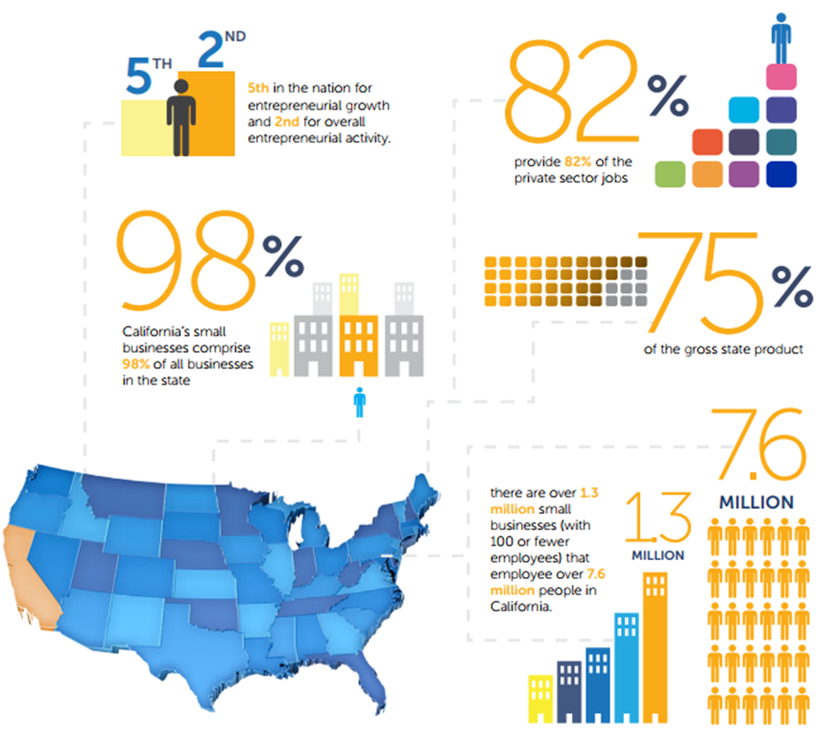
Smal
l
Business

Slide 11
QUESTIONS?
Thank you
Alese Campbell
Small Business Deputy Sector Navigator
California Community Colleges Economic and Workforce Development Program
(209) 481-9605 acampbell@deltacollege.edu
doingwhatmatters.cccco.edu

