Slide 1
Data Tools Update

Slide 2
LaunchBoard – Snapshot
Macro- regions
View by Top 4
Add a sector – Prop 39
Add a sector – Public and Protective Services
Can view programs at selected institution
Expanded Equity Reports (program, skills-builders, demographics)

Slide 3
Common Metrics – October 2016
New list of metrics
New common metrics tab
Public-facing tab (Region and Sector) on Doing What Matters website

Slide 4
Contract Education Survey
New statewide survey completed
Will be distributed via TAP Sandra Sisco
Twenty questions including sector, institution, students served, businesses served
Will roll into the LaunchBoard

Slide 5
New Resource Available
http://dwmpracticeswithpromise.com/cteresources/resources.asp
Industry Engagement
Data Backed Decision Making
Contextualized Content
Student Engagement and Career Awareness
Regional Collaboration

Slide 6
TA Grants
“Find It. Understand It. Use It.”
Funds – Distributed by Rancho Santiago
Data Unlocked Exec Committee meets in June – develop comprehensive plan to deliver TA
For colleges who did not have a VP attend – custom training available
https://docs.google.com/spreadsheets/d/1bcNHeAs-t9j7g5EtJ7Qstbcw3CQrjfe1UA8ri6HxpjU/edit?pref=2&pli=1#gid=1991160915)

Slide 7
CTE Data Unlocked: Use It
REGIONAL PLANNING (fall 2016)
Data reports that examine WIOA-aligned outcomes
Meetings to support the development of regional workforce plans

Slide 8
Under Development
Regional Plans
Additional Resources – Guides, Videos, Trainings, Webinars, Custom Training
Workshops – Usage case based
program review
accreditation
new programs

Slide 9
Data Unlocked - Technical Assistance Examples
TRAINING
Examine and discuss outcomes for specific programs and departments
Learn how to use employment data for educational planning and to strengthen support services
DATA CLEAN UP
Align TOP and SAM code assignments
Identify and upload missing data points
DATA INTEGRATION
Pull and format data for program review, accreditation, and planning

Slide 10
Funding Examples
COMMUNICATIONS
Develop outreach and educational planning materials based on CTE data
Document skills-builder pathways and stories
TOOL INTEGRATION
Support staffing to scale CATEMA system implementation
Improve response rates for the CTE Outcomes Survey
SUPER-CHARGE TECHNICAL ASSISTANCE
Use funding to expand technical assistance activities
Note: You can suggest other technical assistance and funding topics, and you can pool resources with other colleges.

Slide 11
Skills-builders & COmpleters
Tools You Can Use:

Slide 12
Skills-Builders: Common Questions
What are my college’s skills-builder pathways like?
Use the Student Success Scorecard to see which programs have the most skills-builders and how these pathways impact students’ earnings
How do skills-builder pathways fit with my college’s completion pathways?
Use the LaunchBoard to see skills-builder information side-by-side with information for completers

Slide 13
Scorecard Display: Completion

Slide 14
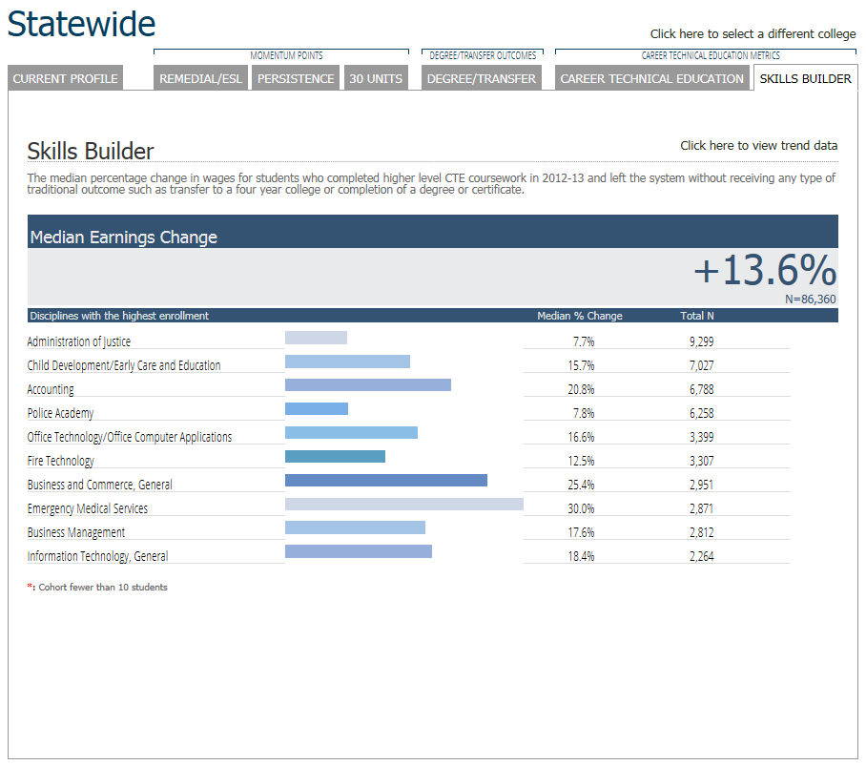
Scorecard Display: Skills-Builders

Slide 15
Focusing In: Earnings (Accounting)
Notes:
San Diego/Imperial Region Accounting Earnings

Slide 16
Focusing In: Earnings (Early Childhood Education)
Completers:
53 students
Skills-builders: 523 students
Notes:
East Bay Region Early Childhood Education

Slide 17
Focusing In: Earnings (ICT)
Notes:
Greater Sacramento Computer Information Systems

Slide 18
Focusing In: Earnings (Registered Nursing)
Notes:
San Diego/Imperial Region Registered Nursing

Slide 19
Small Group Work
Break into small groups (ideally with the team from your college)
Open one browser window to the Student Success Scorecard at http://scorecard.cccco.edu/scorecard.aspx
Keep a second window on your browser on the LaunchBoard at www.calpassplus.org/Launchboard/Snapshot.aspx
Use the worksheet to complete the exercise
There will be a chance to share observations at the end of the break-out

Slide 20
Discussion
How did including skills-builders change the picture of success for these CTE programs?
Given the number of skills-builders in CTE programs, are there implications for policies like enrollment priority, matriculation, prerequisites, and repeatability?
How could this information be used in advising or communications, for programs with large numbers of skills-builders?

Slide 21
Contact
Renah Wolzinger
Technical Assistance Provider for Data Tools
Research Associate – WestEd
rwolzin@wested.org
Kathy Booth
kbooth@wested.org

